Slide 1

Sunday – March 26

Slide 2
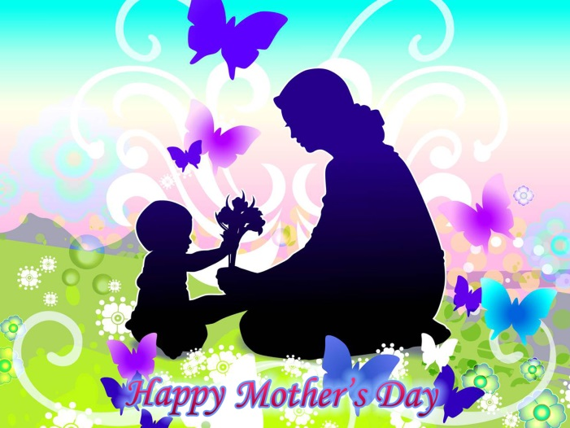
Mother’s Day – Sunday, March 26
Are the plans made and the cards made/bought?
Don’t worry; you still have time! …
But do you know where the tradition comes from?

Slide 3

Some Information about Mother’s Day
In Ireland and the UK, Mother’s Day or Mothering Sunday is always on the fourth Sunday of Lent.
In the USA and other countries, it is celebrated on the second Sunday in May.
Whenever you honour the matriarch of your family; the origins and celebrations of her special day are fascinating.

Slide 4
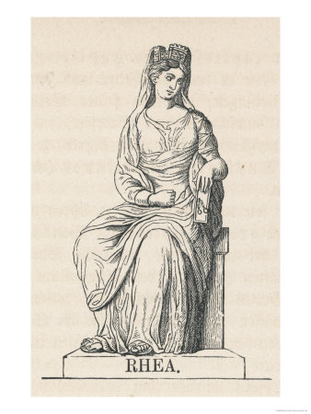
The origins of Mother’s Day
The earliest Mother’s Day celebrations can be traced back to the spring festivities of ancient Greece, in honour of Rhea; the Mother of the Gods.

Slide 5
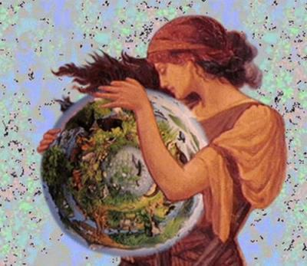
The origins of Mother’s Day
In Rome, the most significant Mother’s Day festival was dedicated to the worship of Cybele; another mother goddess. Ceremonies in her honour began some 250 years before Christ was born.
This roman religious celebration, known as Hilaria, lasted for three days – from March 15 – 18.

Slide 6
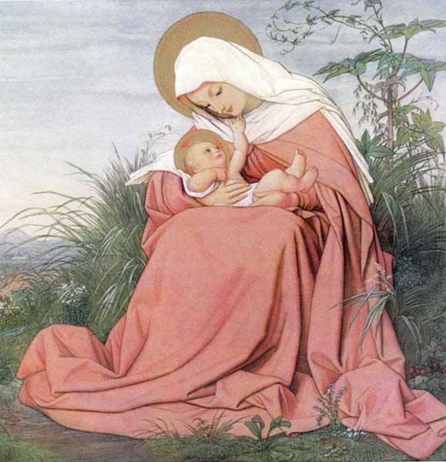
Laetare Sunday
As Christianity spread throughout Europe, Mother’s Day celebrations were held on the fourth Sunday of Lent – Laetare Sunday or ‘mid-Lent’ Sunday – the celebrations were adapted to honour the Virgin Mary and also the ‘Mother Church’.
Customs began to dictate that a person visit the church of his/her baptism on this day. People also attended the mother church of their parish, laden with offerings.

Slide 7

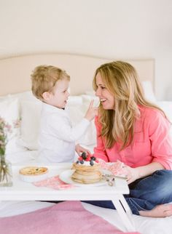

The origins of Mother’s Day
Eventually, the custom of
making donations to one’s Mother Church
expanded to include
honouring one’s own mother.

Slide 8
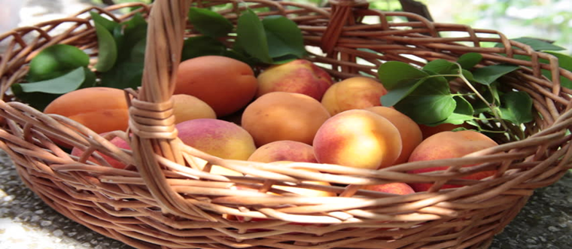
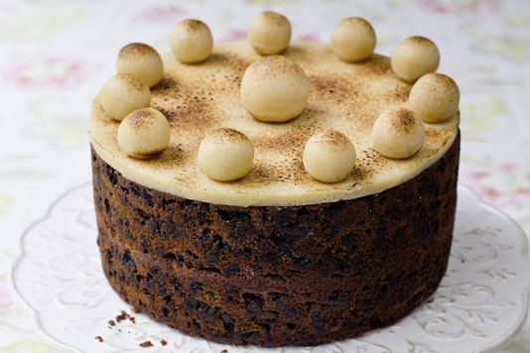
The origins of Mother’s Day
Young people, such as servants and apprentices, were given the day off to visit their mothers and take gifts of food, which sometimes included a special mothering cake.
Often this would be a very rich fruit-laden mixture, known as Simnel cake.

Slide 9
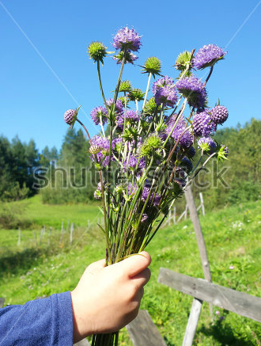
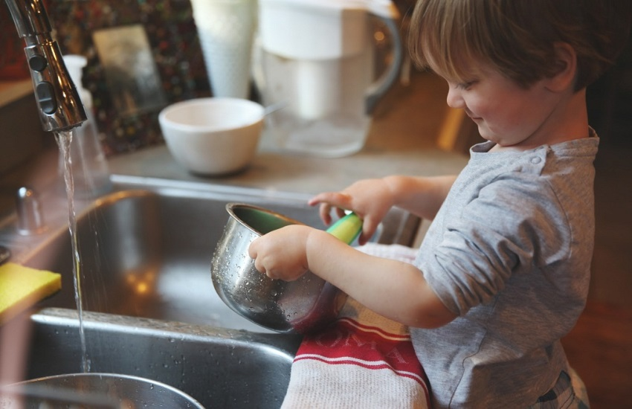
The origins of Mother’s Day
They would also bring her bouquets of spring flowers which were blessed in Church first.
It was also customary for sons and daughters to take on the mother’s chores.

Slide 10
Celebrating Mother’s Day
So this year, why not learn from those who celebrated Mother’s Day long ago? ...
You could:
make your card, rather than buy one
make or bake your gifts!
Rather than spending money; why not offer to do some housework to give Mum or Dad/Grandparents a well-earned rest?

Slide 11
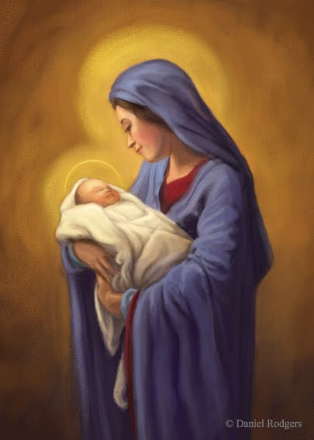
Prayer to Mary, Our Mother
Mary, my dearest mother,
Give me your heart
so beautiful, so pure,
so immaculate,
so full of love and humility,
That I may receive Jesus as you did – and go in haste to give him to others.
Saint Teresa of Calcutta

Slide 12
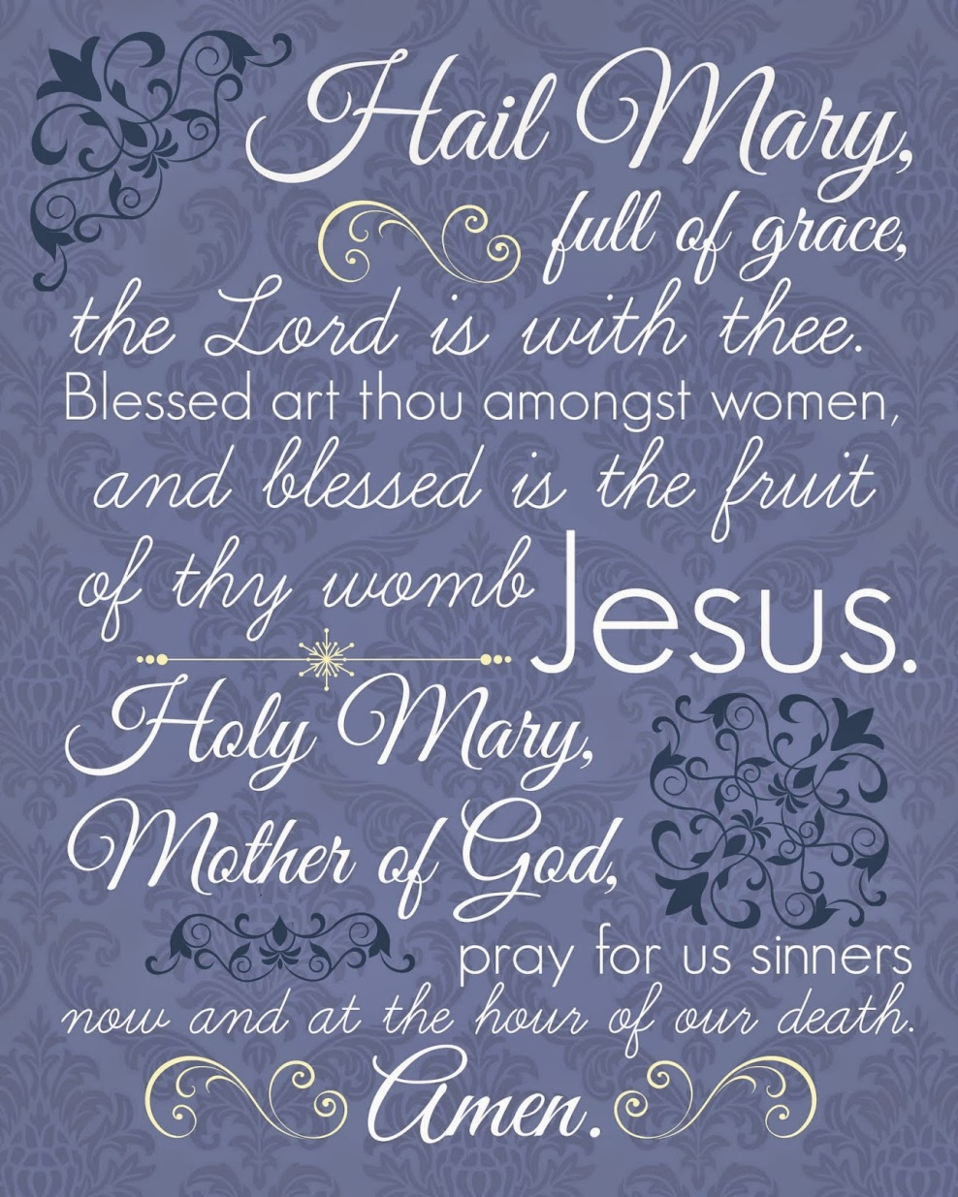
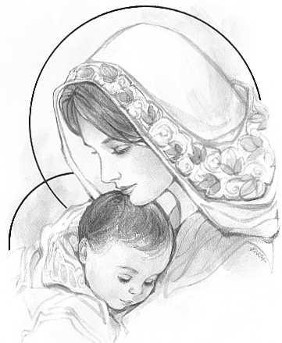
A Prayer to honour Mary, Our Mother in Heaven on Mother’s Day

Slide 13

We pray for mothers everywhere

