Slide 1
The Wedding in Cana
(Jn 2: 1-12)

Slide 2
The Wedding in Cana (Jn 2: 1-12)
Two days later, there was a wedding in the town of Cana in Galilee. Jesus’ mother was there, and Jesus and his disciples had been invited to the wedding. When the wine had given out, Jesus mother said to him, “they are out of wine.”
“You must not tell me what to do,” Jesus replied, “my time has not yet come.”
Jesus’ mother then told the servants, “Do whatever he tells you.”
The Jews have rules about ritual washing, and for this purpose six stone water jars were there, each one large enough to hold between twenty and thirty gallons. Jesus said to the servants, “Fill these jars with water,” They filled them to the brim, and then he told them, “Now draw some water out and take it to the man in charge of the feast.” They took him the water, which now had turned into wine, and he tasted it. He did not know where this wine had come from (but of course, the servants who had drawn out the water knew); so he called the bridegroom and said to him, “ Everyone else serves the best wine first, and after the guests have drunk a lot, he serves the ordinary wine. But you have kept the best wine until now!”
Jesus performed this first miracle in Cana in Galilee; there he revealed his glory, and his disciples believed in him.
After this, Jesus, and his mother, brother, and disciples went to Capernaum and stayed there a few days.

Slide 3
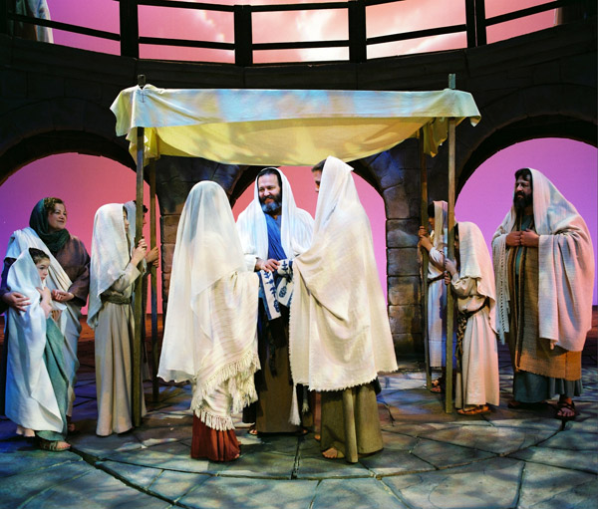
Two days later, there was a wedding in the town of Cana in Galilee.

Slide 4
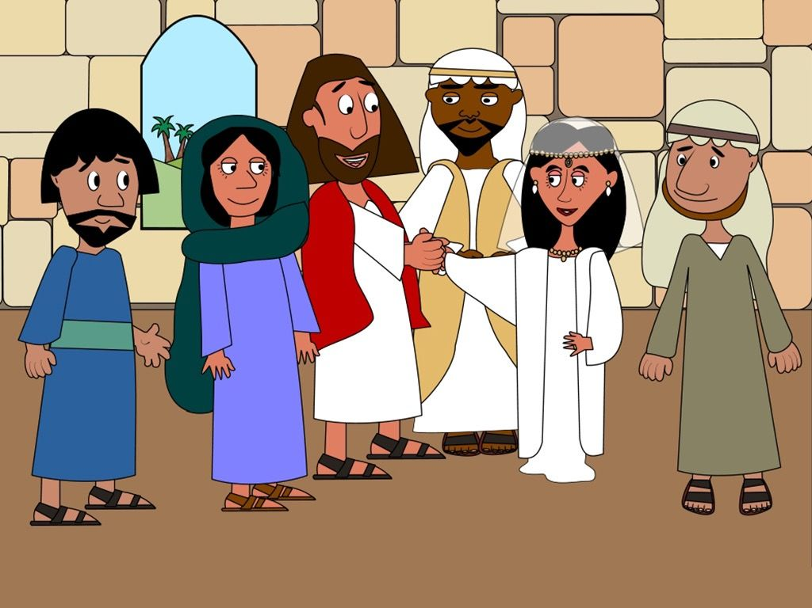
Jesus’ mother was there, and Jesus and his disciples had been invited to the wedding.

Slide 5
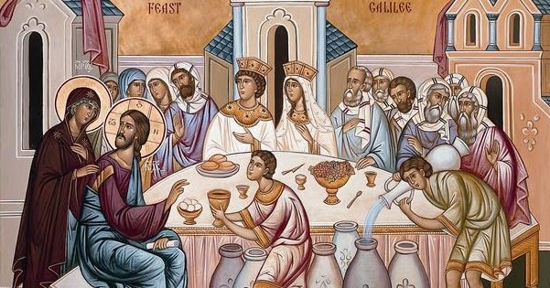
When the wine had given out, Jesus’ mother said to him, “they are out of wine.”

Slide 6
“You must not tell me what to do,” Jesus replied, “my time has not yet come.”

Slide 8
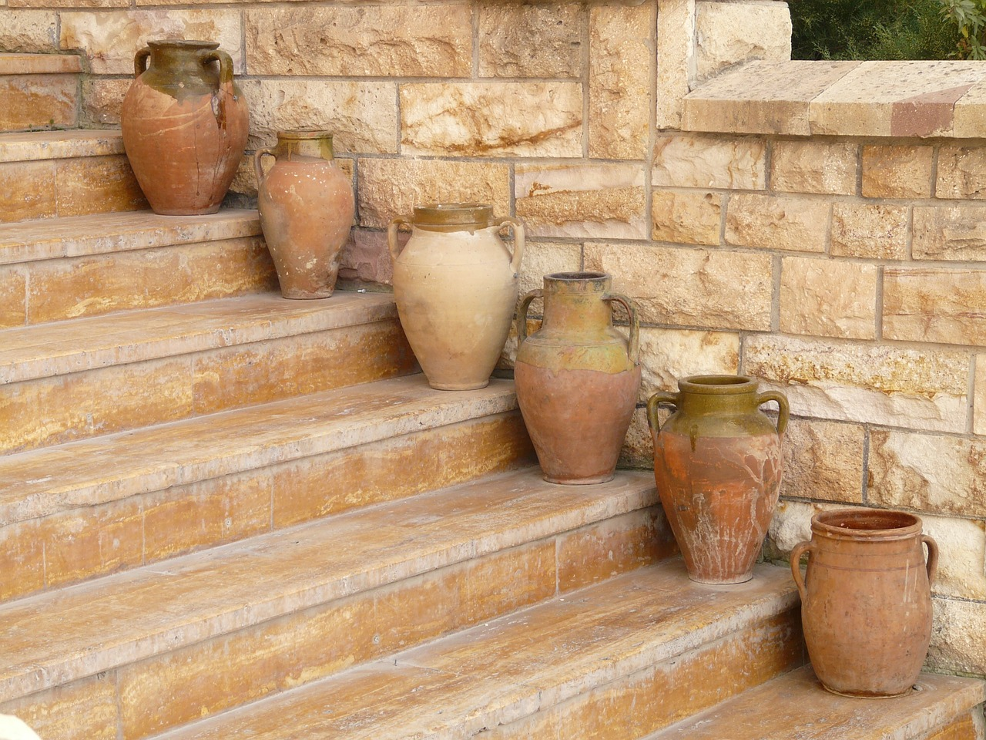
The Jews have rules about ritual washing, and for this purpose six stone water jars were there, each one large enough to hold between twenty and thirty gallons

Slide 9
Jesus said to the servants,
“Fill these jars with water.”

Slide 10
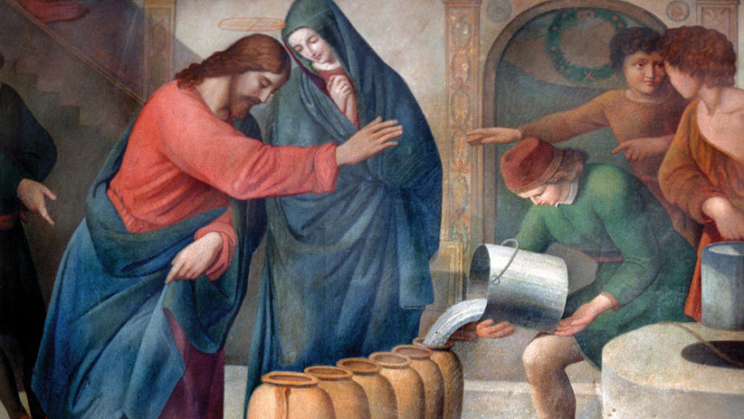
They filled them to the brim, and then he told them, “Now draw some water out and take it to the man in charge of the feast.”

Slide 11
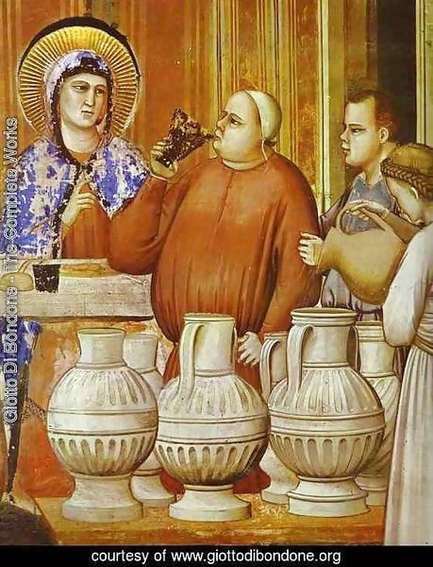
Jesus’ mother then told the servants, “Do whatever he tells you.”
They took him the water, which now had turned into wine, and he tasted it.

Slide 12
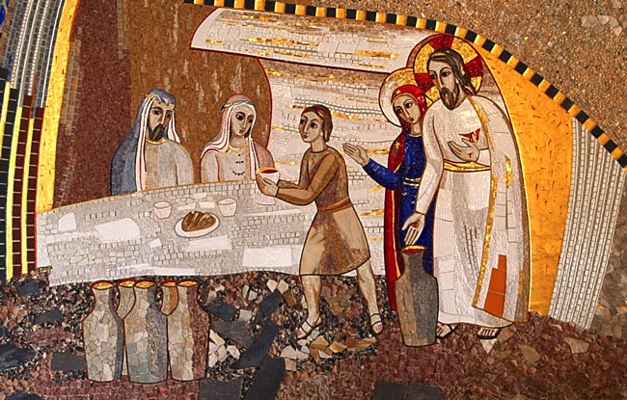
He did not know where this wine had come from (but of course, the servants who had drawn out the water knew); so he called the bridegroom and said to him,
“ Everyone else serves the best wine first, and after the guests have drunk a lot, he serves the ordinary wine. But you have kept the best wine until now!”

Slide 13
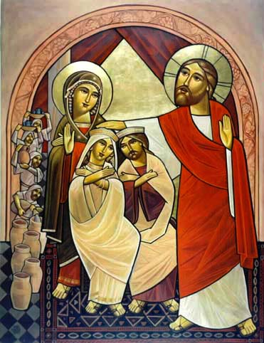
Jesus performed this first miracle in Cana in Galilee;

Slide 14
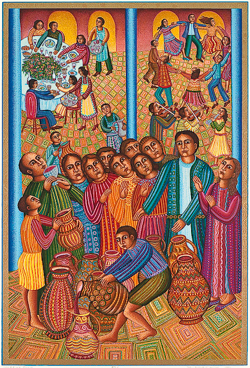
there he revealed his glory, and his disciples believed in him.

Slide 15
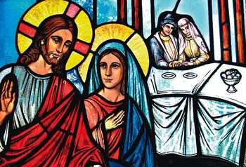
After this, Jesus, and his mother, brother, and disciples went to Capernaum and stayed there a few days.

