Slide 1
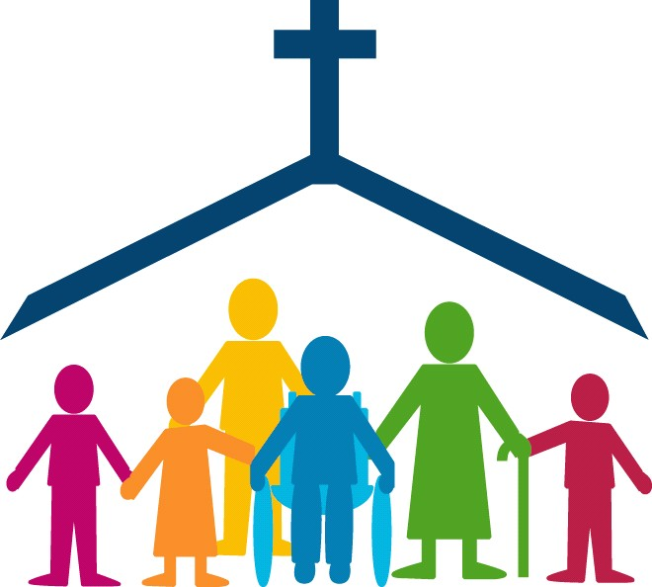
Gathering Song
Bernard Sexton

Slide 2
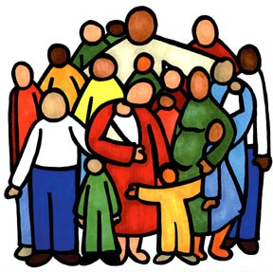
Come, let us gather before Him.
Come, let us give thanks here today.
Come, let us pray to the Father,
For He has shown us the way.

Slide 3
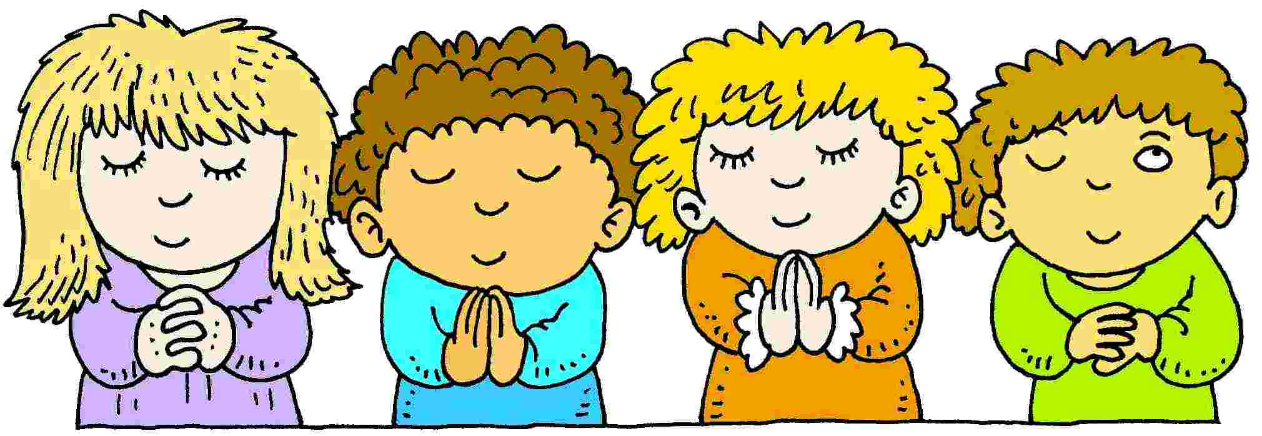
Jesus has called us by name.
Jesus has taught us to pray.
As friends we gather in His name.
With joy we sing and we say.

Slide 4
Come, let us gather before Him.
Come, let us give thanks here today.
Come, let us pray to the Father,
For He has shown us the way.

Slide 5
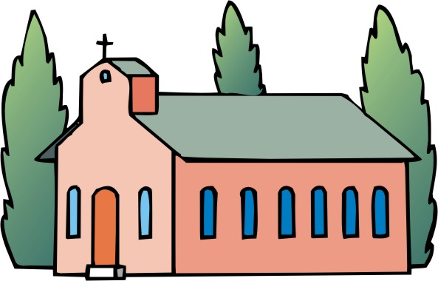
Let us sing praise to the Lord.
All who now gather to pray
Now celebrate the love of God
On this, the Lord’s special day.

Slide 6
Come, let us gather before Him.
Come, let us give thanks here today.
Come, let us pray to the Father,
For He has shown us the way.

Slide 7
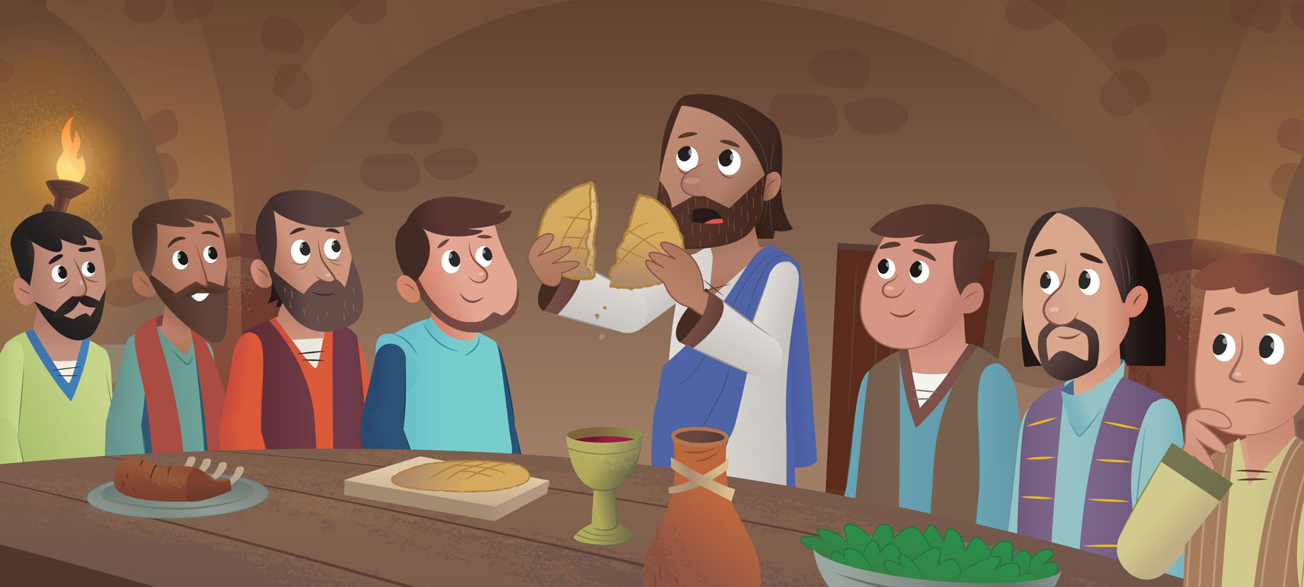
Jesus had very good friends
Who stayed with him all of the time
They followed Him wherever he went
And shared His bread and His wine.

Slide 8
Come, let us gather before Him.
Come, let us give thanks here today.
Come, let us pray to the Father,
For He has shown us the way.

