Slide 1
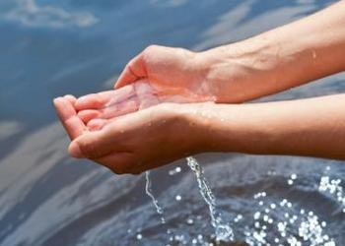
Baptism Song Bernard Sexton
Water, holy water over our heads.
Water, holy water over our heads.

Slide 2
We are baptised in God’s name.
We are the children of God.
We are the children of God.

Slide 3
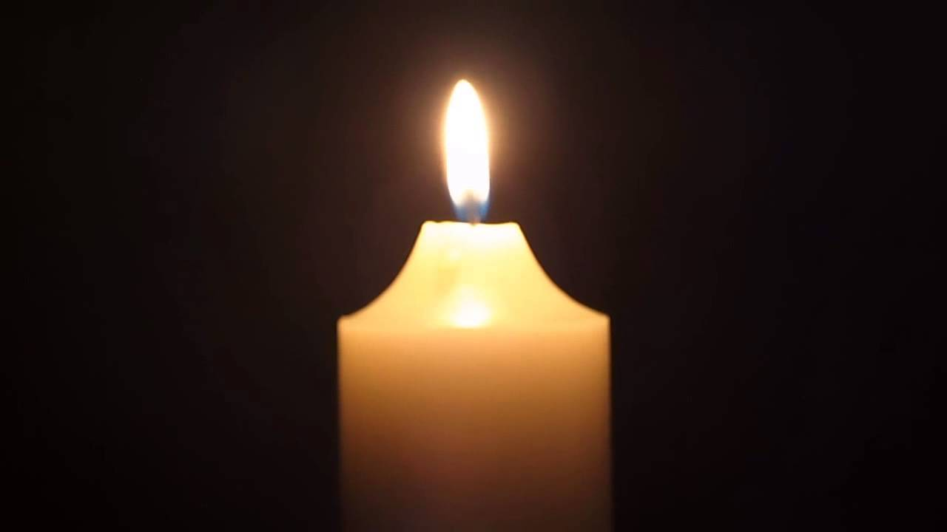
Candle, burning candle,
God is with us.
Candle, burning candle,
God is with us.

Slide 4
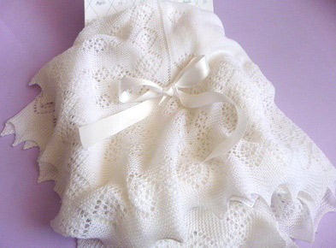
Garment, white garment, sign of love.
Garment, white garment, sign of love.

