Slide 1
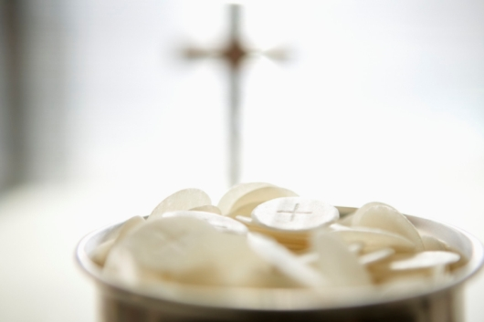
Agnus Dei
Bernard Sexton

Slide 2
Lamb of God you take away the sins of the world.
Have mercy on us.
HAVE MERCY ON US.
Lamb of God you take away the sins of the world.
Have mercy on us.
HAVE MERCY ON US.
Lamb of God you take away the sins of the world.
Grant us peace.
GRANT US PEACE.

