Slide 1
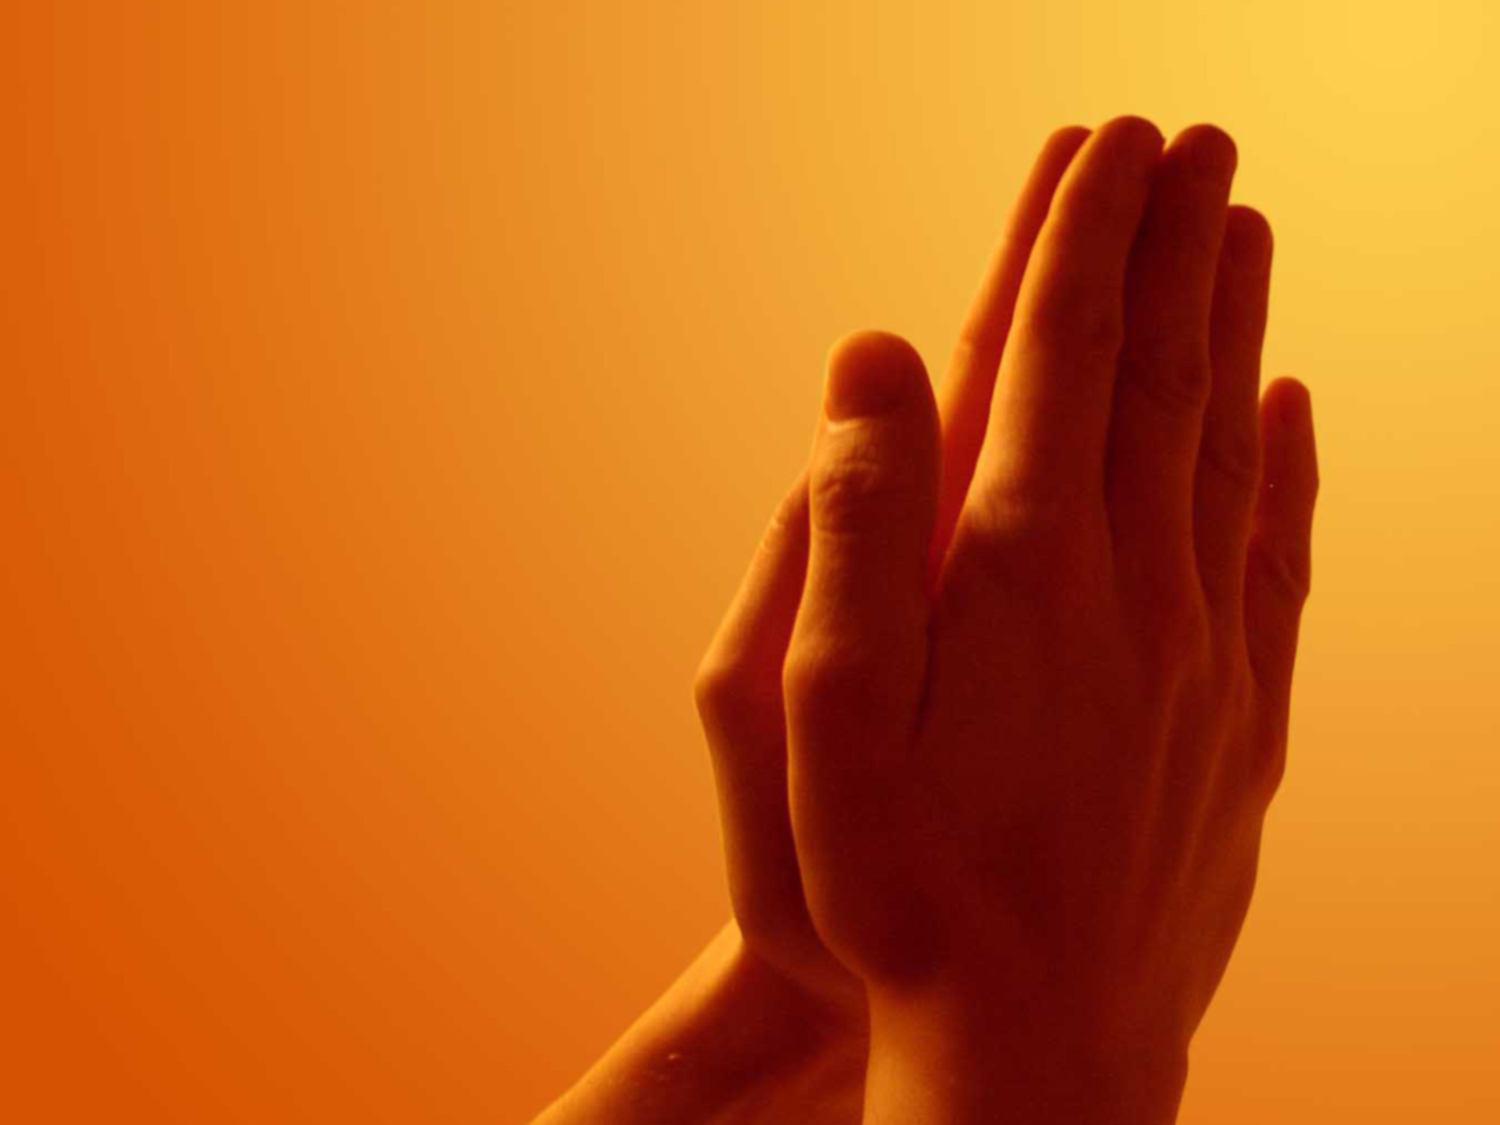
Amen
Bernard Sexton

Slide 2
Through him, and with him and in him, O God almighty Father,
in the unity of the Holy Spirit,
all glory and honour is yours,
forever and ever.
Amen, Amen, Amen.

