Slide 1
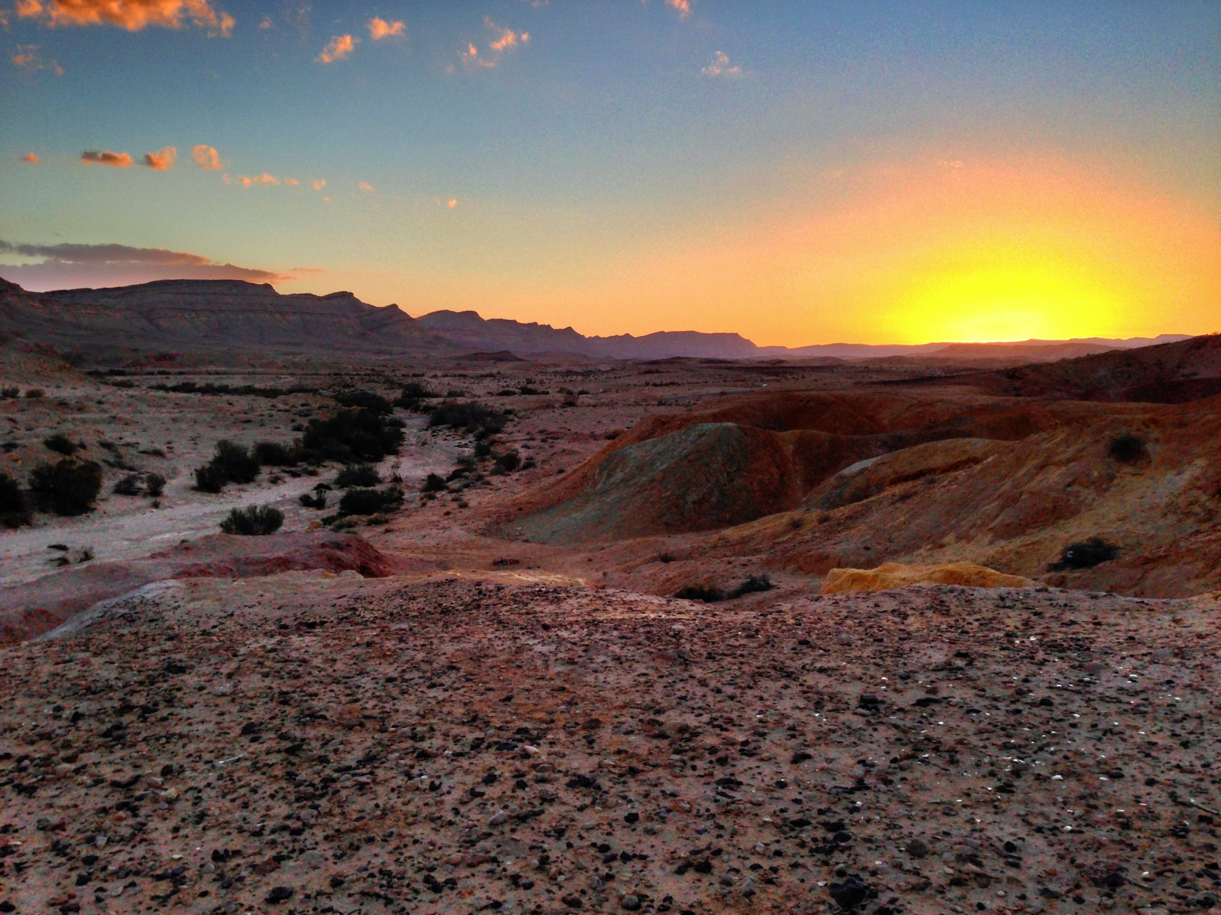
Baruch Atah

Slide 2
Barukh ata Adonai eloheinu, eloheinu, Adonai, barukh ata Adonai eloheinu, eloheinu, Adonai.

Slide 3
All praise to you our God, The God who will last forever The God who rules over all the earth, And all the planets high up in the sky.

Slide 4
Barukh ata Adonai eloheinu, eloheinu, Adonai, barukh ata Adonai eloheinu, eloheinu, Adonai.

Slide 5
All praise to you our God, The God who gave us our lives The God who protects us as we live And helps us to be who we are today.

Slide 6
Barukh ata Adonai eloheinu, eloheinu, Adonai, barukh ata Adonai eloheinu, eloheinu, Adonai.

