Slide 1
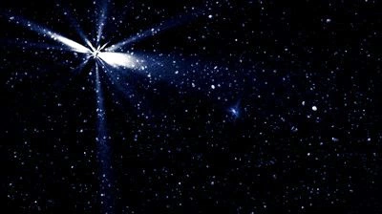
This Little Light of Mine
This Little Light of Mine
Traditional American

Slide 2
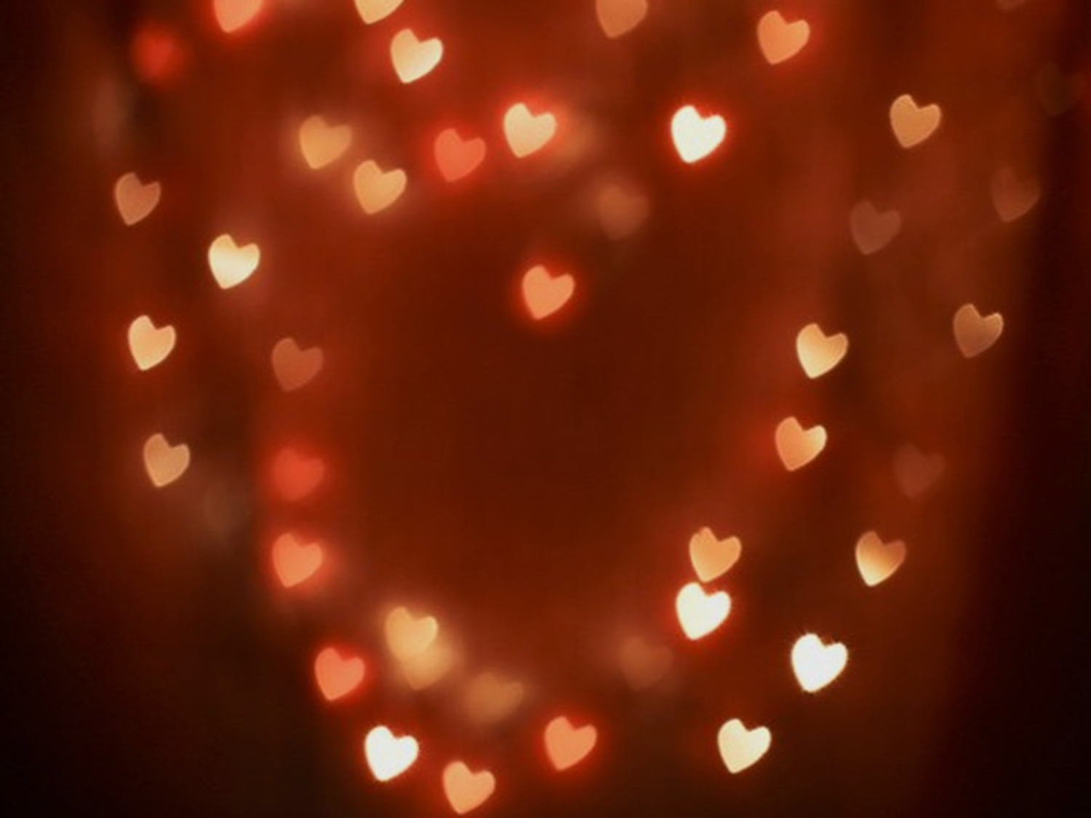
This little light of mine, I'm gonna let it shine.
This little light of mine, I'm gonna let it shine.
This little light of mine, I'm gonna let it shine.
Let it shine, let it shine, let it shine.

Slide 3

The light that shines is the light of love,
lights the darkness from above
It shines on me, shines on you,
and shows what the pow’r of love can do.
Gonna shine my light both far and near
Shine my light both bright and clear.
Where there’s a dark corner in this land
I’m gonna let my little light shine.

Slide 4

This little light of mine, I'm gonna let it shine.
This little light of mine, I'm gonna let it shine.
This little light of mine, I'm gonna let it shine.
Let it shine, let it shine, let it shine.

