Slide 1
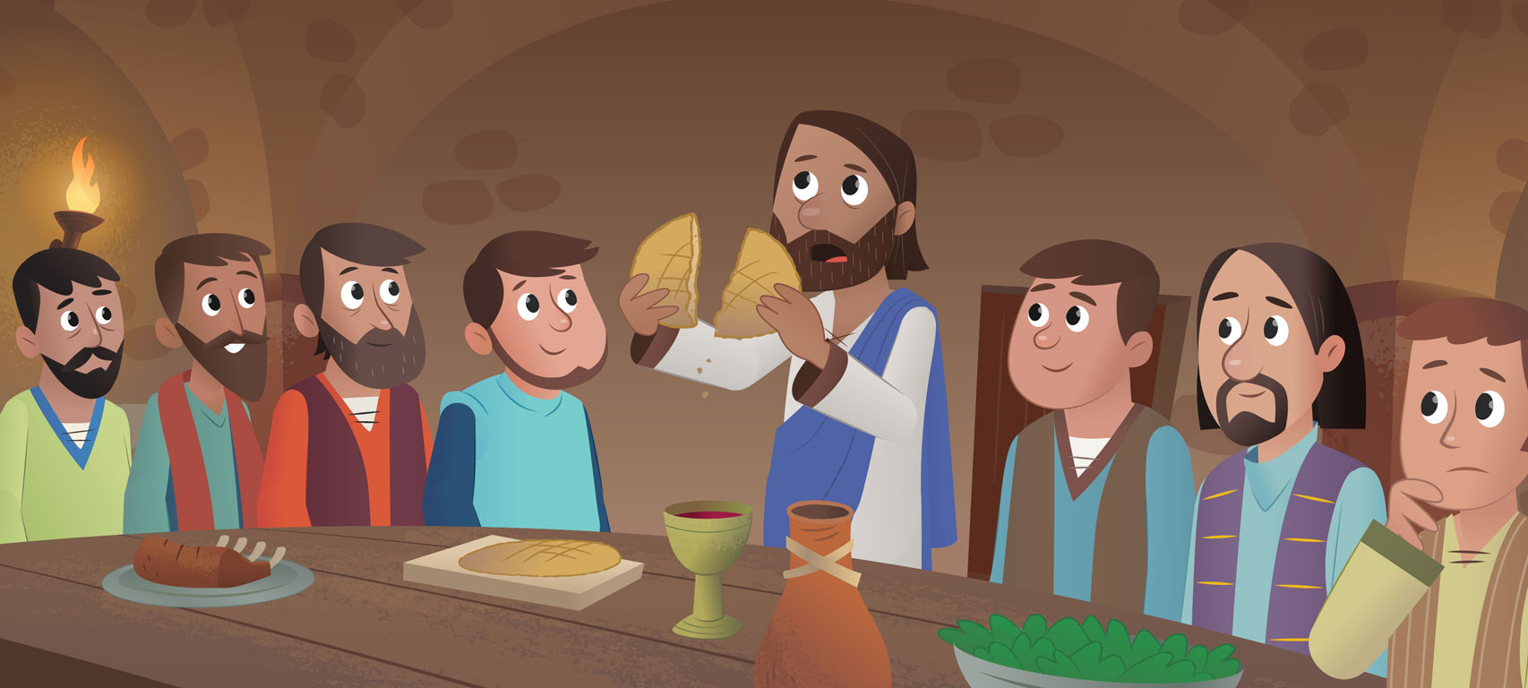
The Last Supper
Bernard Sexton

Slide 2
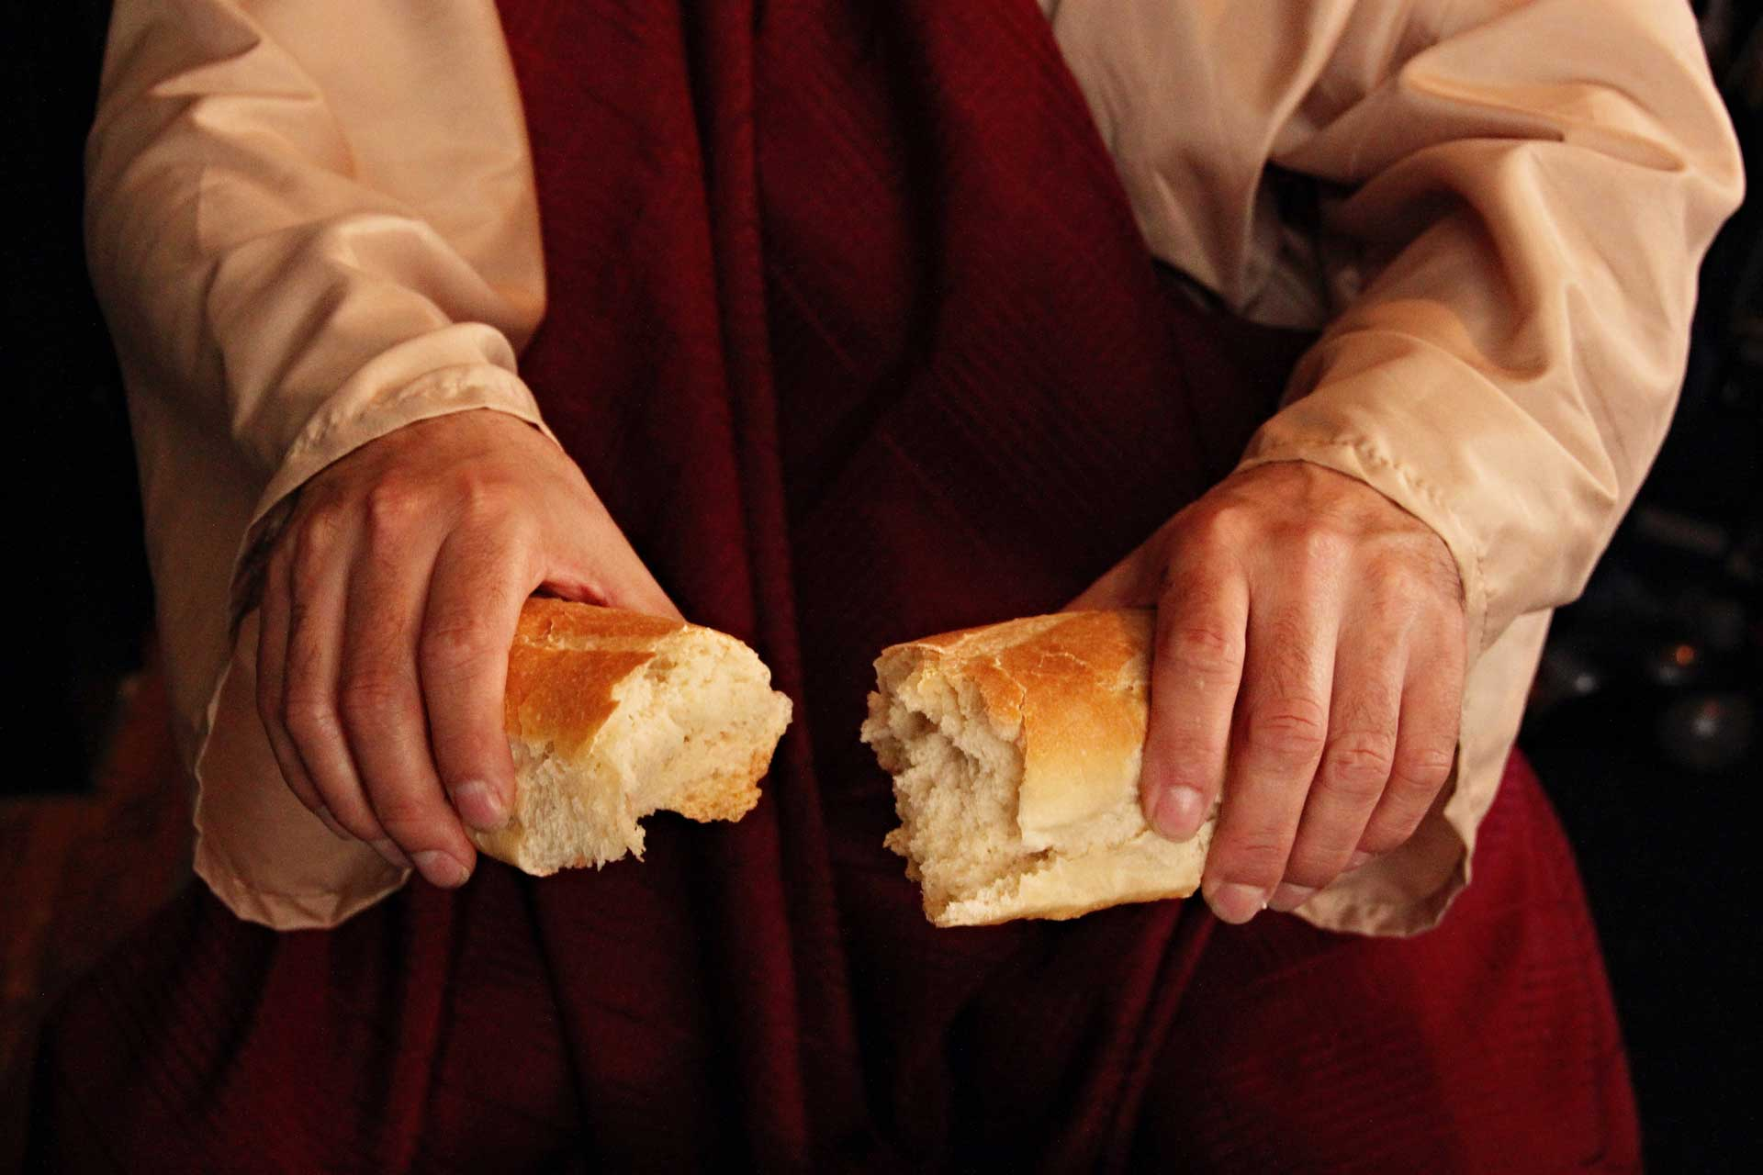
Jesus took the bread he broke.
Jesus shared the bread he broke and said,
“Do this, do this in memory of me.”

Slide 3
Jesus took the wine he poured.
Jesus shared the wine he poured and said,
“Do this, do this in memory of me.”

