Slide 1
Day 2

Slide 2
Let’s look at other artists drawings of the Last Supper that took place on Holy Thursday

Slide 4
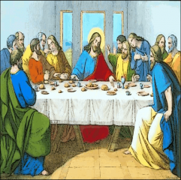

Slide 5
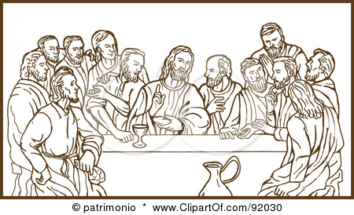

Slide 6
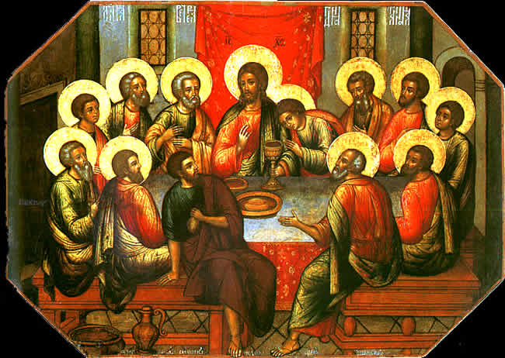

Slide 7
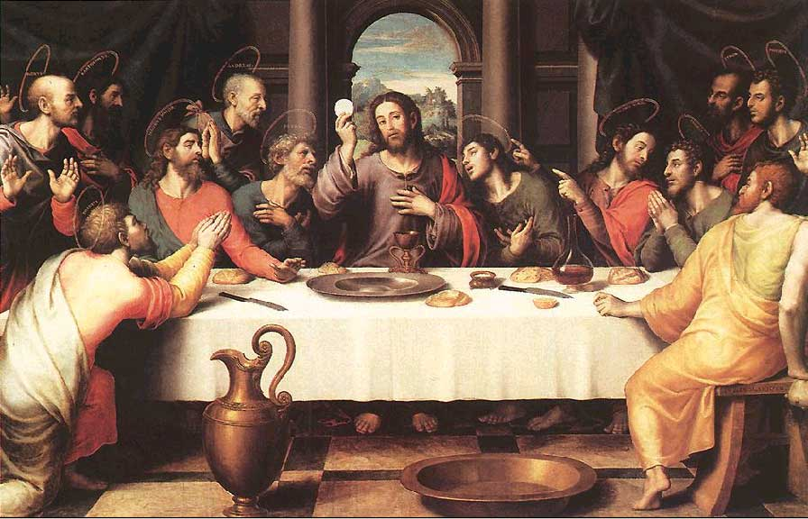

Slide 8
Chatting
Look at the faces of the main characters.
What do you think they are saying/feeling/thinking?
What story do the pictures tell?

Slide 9
Prayertime P251/252

Slide 10
Let’s sing “The Passover Song”
Jesus was celebrating the Passover with his friends.......

Slide 11
The Passover Song
Baruh Atah Adonai Eloheinu
Eloheinu Adonai (x2)
Remember the Passover story
Remember the Passover meal
Remember the journey to freedom
Moses said “Let my people go free”
Remember the Passover story
Remember the Passover meal
Remember the eating of unleavened bread
“People! Make ready to flee!”

Slide 12
Let’s do the next part of our worksheet

Slide 13
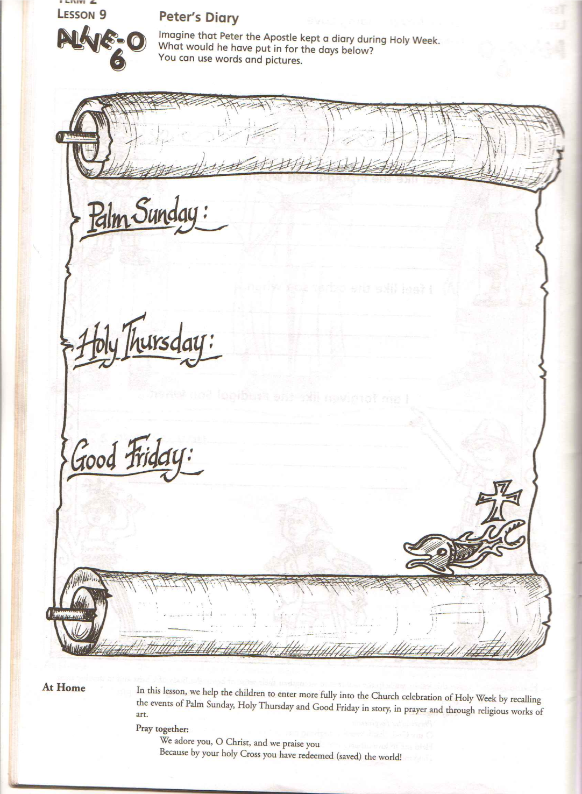

Slide 14
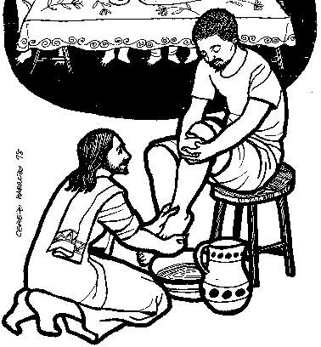
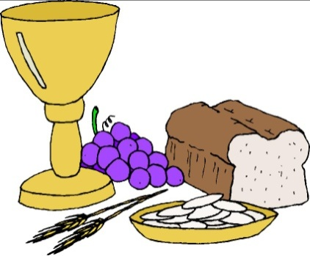
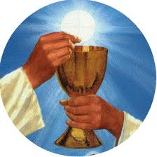
Images for Holy Thursday
love
service
First Mass

Slide 15
Day 3

Slide 16
The Passover Song
Baruh Atah Adonai Eloheinu
Eloheinu Adonai (x2)
Remember the Passover story
Remember the Passover meal
Remember the journey to freedom
Moses said “Let my people go free”
Remember the Passover story
Remember the Passover meal
Remember the eating of unleavened bread
“People! Make ready to flee!”

Slide 17
The Stations of the Cross
First Station: Jesus is condemned to death
Second Station: Jesus carries His cross
Third Station: Jesus falls the first time
Fourth Station: Jesus meets his mother
Fifth Station: Simon of Cyrene helps Jesus to carry his cross
Sixth Station: Veronica wipes the face of Jesus
Seventh Station: Jesus falls the second time
Eighth Station: Jesus meets the women of Jerusalem
Ninth Station: Jesus falls a third time
Tenth Station: Jesus clothes are taken away
Eleventh Station: Jesus is nailed to the cross
Twelfth Station: Jesus dies on the cross
Thirteenth Station: Jesus is taken from the Cross
Fourteenth Station: Jesus is laid in a tomb

Slide 18
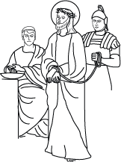
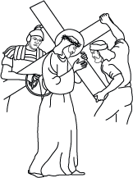
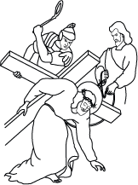
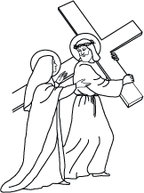
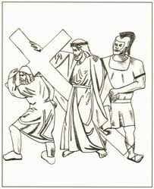
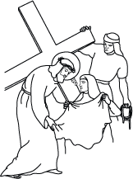
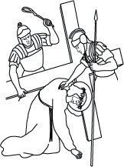
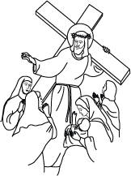

Slide 19
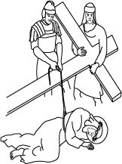
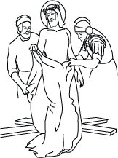
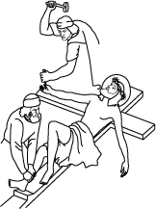
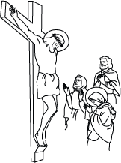
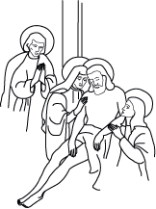
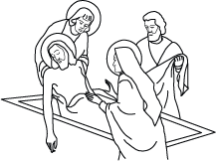

Slide 21
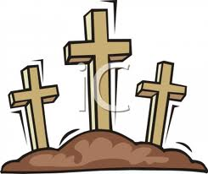
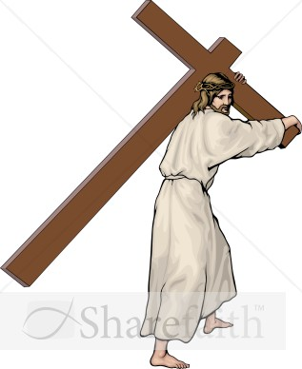
Images for Good Friday
sacrifice
Love

Slide 22
Day 4

Slide 23
Stabat Mater
1. At the cross her vigil keeping
Mary stood in sorrow weeping
When her son was crucified
2. Hour of darkness descending
Mother, son, love unending
On the hill of Calvary
3. Mary, Mary crying
Slowly Jesus dying
Crucified, crucified
4. Body bowed and broken,
Breath, breathed, last word spoken
“Abba! Father! Amen”.

Slide 24
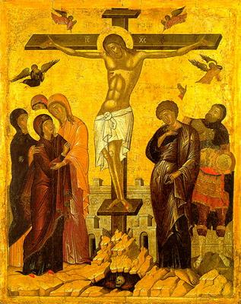

Slide 25
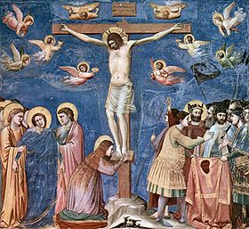

Slide 26
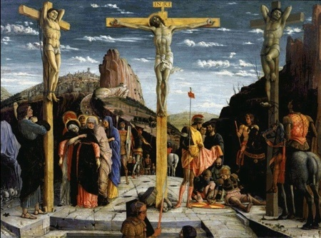

Slide 27
The Stations of the Cross
First Station: Jesus is condemned to death
Second Station: Jesus carries His cross
Third Station: Jesus falls the first time
Fourth Station: Jesus meets his mother
Fifth Station: Simon of Cyrene helps Jesus to carry his cross
Sixth Station: Veronica wipes the face of Jesus
Seventh Station: Jesus falls the second time
Eighth Station: Jesus meets the women of Jerusalem
Ninth Station: Jesus falls a third time
Tenth Station: Jesus clothes are taken away
Eleventh Station: Jesus is nailed to the cross
Twelfth Station: Jesus dies on the cross
Thirteenth Station: Jesus is taken from the Cross
Fourteenth Station: Jesus is laid in a tomb

Slide 30
Jesus died on the cross on Good Friday

Slide 31
Day 5

Slide 32
The Passover Song
Baruh Atah Adonai Eloheinu
Eloheinu Adonai (x2)
Remember the Passover story
Remember the Passover meal
Remember the journey to freedom
Moses said “Let my people go free”
Remember the Passover story
Remember the Passover meal
Remember the eating of unleavened bread
“People! Make ready to flee!”

Slide 33
Stabat Mater
1. At the cross her vigil keeping
Mary stood in sorrow weeping
When her son was crucified
2. Hour of darkness descending
Mother, son, love unending
On the hill of Calvary
3. Mary, Mary crying
Slowly Jesus dying
Crucified, crucified
4. Body bowed and broken,
Breath, breathed, last word spoken
“Abba! Father! Amen”.

Slide 34
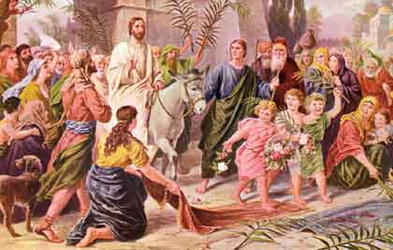

Slide 37
The Stations of the Cross
First Station: Jesus is condemned to death
Second Station: Jesus carries His cross
Third Station: Jesus falls the first time
Fourth Station: Jesus meets his mother
Fifth Station: Simon of Cyrene helps Jesus to carry his cross
Sixth Station: Veronica wipes the face of Jesus
Seventh Station: Jesus falls the second time
Eighth Station: Jesus meets the women of Jerusalem
Ninth Station: Jesus falls a third time
Tenth Station: Jesus clothes are taken away
Eleventh Station: Jesus is nailed to the cross
Twelfth Station: Jesus dies on the cross
Thirteenth Station: Jesus is taken from the Cross
Fourteenth Station: Jesus is laid in a tomb

Slide 38
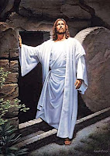
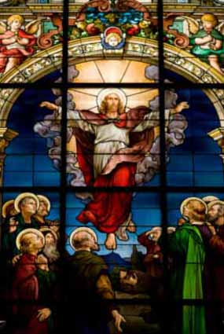

Slide 39
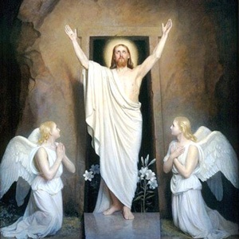
Prayertime P259/260

