Slide 1
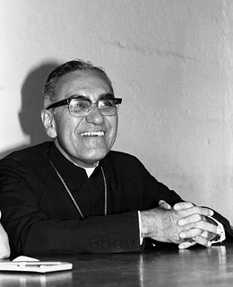
The Heart of the Poor
Archbishop Oscar Romero was beatified on May 23, 2015; this begins the road to sainthood.

Slide 3
Lord, show us
the heart of the poor

Slide 4
For they
have
shown us
the true way to live

Slide 5
Lord, show us
the way of the poor

Slide 6
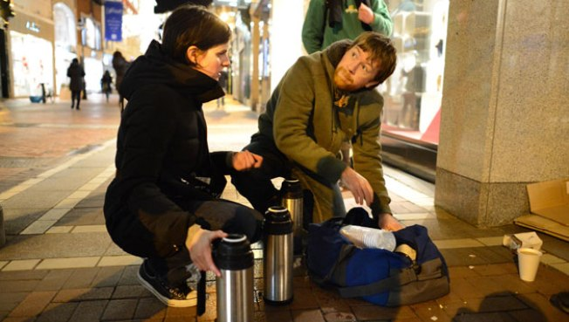
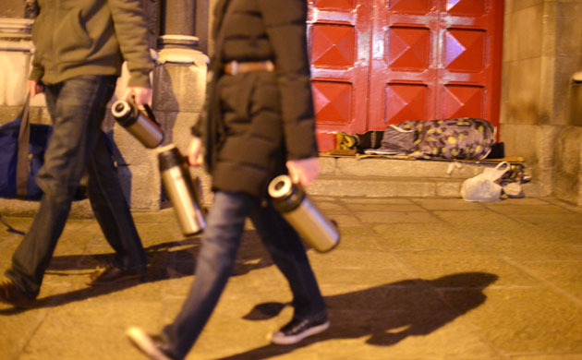
To be the
true Church
of Christ

Slide 7
Lord, show us
the heart of the poor

Slide 8
For they
have
shown us
the true way to live

Slide 9
Lord, show us
the way of the poor

Slide 10
To be the
true Church
of Christ

Slide 11
Lord, show us
the heart
of the poor

Slide 12
For they have shown us
the true way to live

Slide 13
Lord, show us
the way
of the poor

Slide 14
To be the
true Church
of Christ

Slide 15
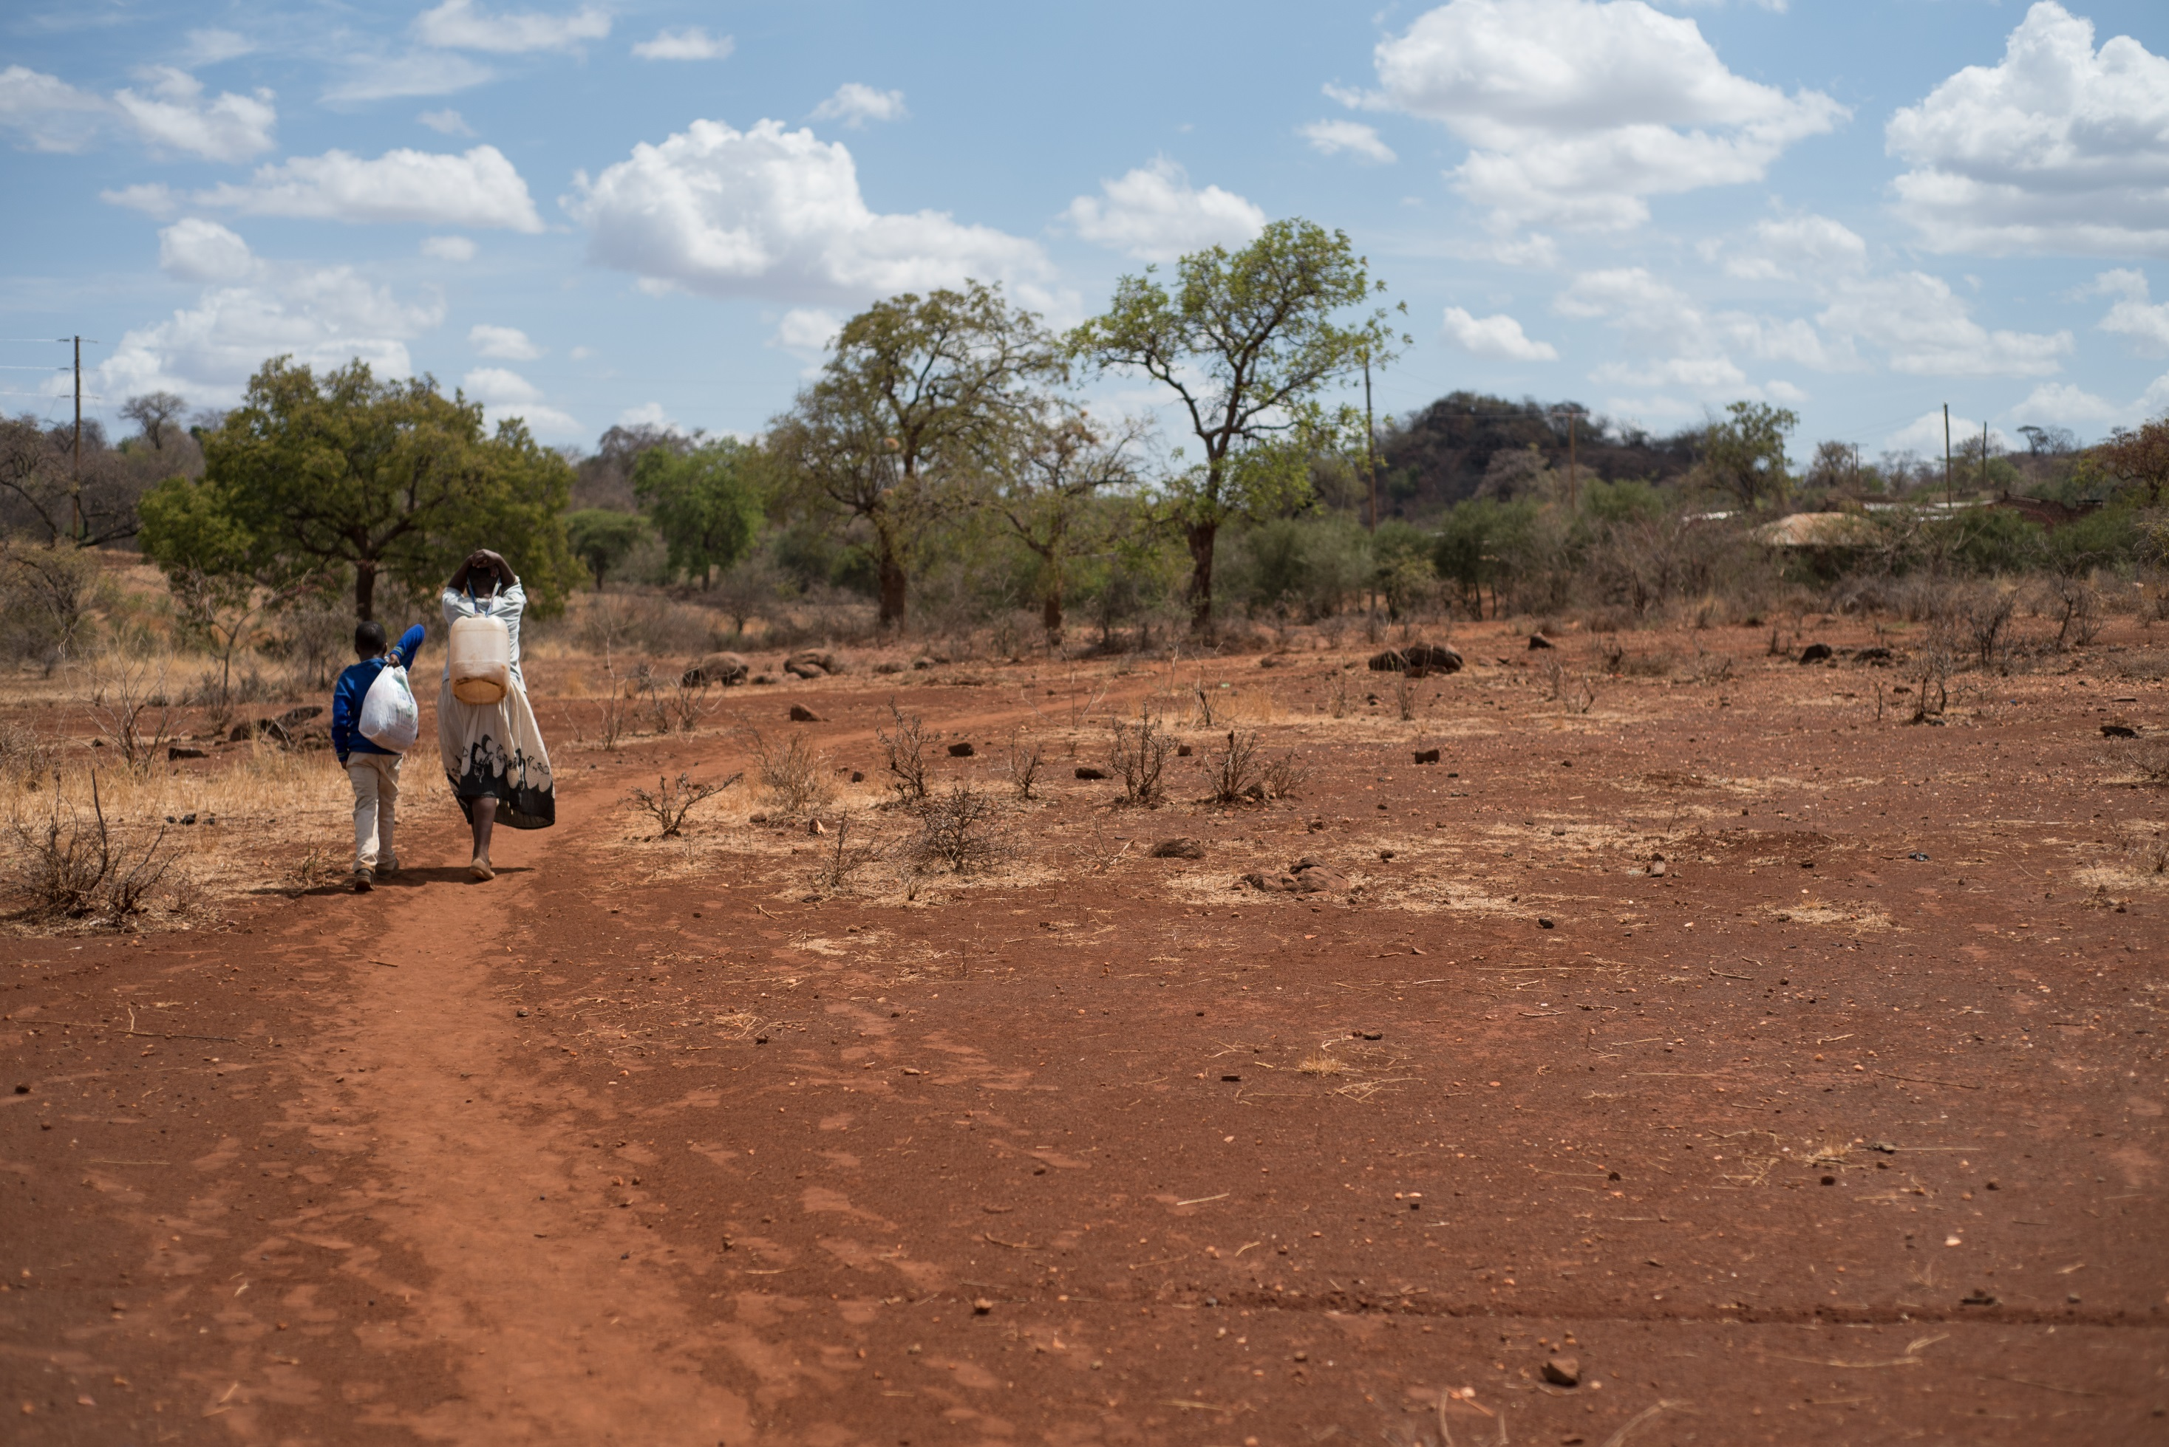

Slide 17
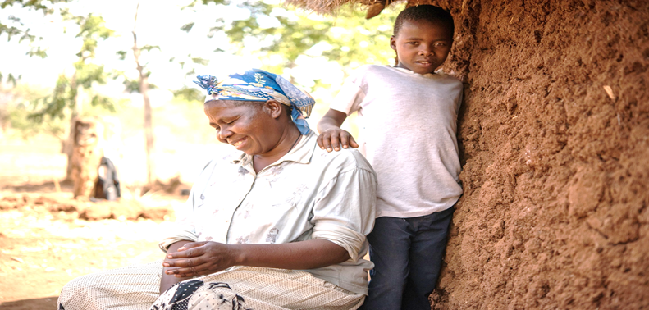

Slide 18
Lord, show us
the heart of the poor

Slide 19
For they have shown us
the true way to live

Slide 20
Lord, show us
the way of the poor

Slide 21
To be the true Church of Christ

Slide 23
For they have shown us
the true way to live

Slide 24
Lord, show us
the way of the poor

Slide 26
Lord, show us
the heart of the poor

Slide 27
For they have shown us
the true way to live

Slide 28
Lord, show us
the way of the poor

Slide 29
To be the true Church of Christ

Slide 32
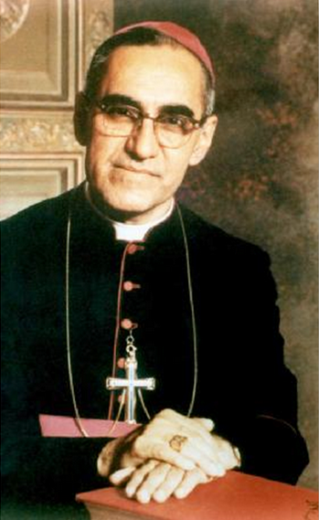
The guarantee of one’s prayer is not in saying a lot of words. The guarantee of one’s petition is very easy to know: how do I treat the poor? The degree to which you approach them and the love with which you approach them, or the scorn with which you approach them – that is how you approach your God. What you do to them, you do to God. The way you look at them is the way you look at God.

Slide 33
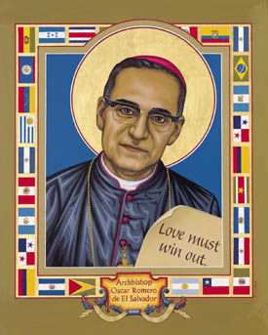
Blessed are the poor, for they know that their riches are in the One who being rich made himself poor in order to enrich us with his poverty, teaching us the true Christian’s wisdom.

Slide 34
Lord, show us
the heart of the poor

Slide 35
For they
have
shown us
the true way to go

Slide 36
Lord, show us
the way of the poor

Slide 37
To be the
true Church
of Christ

