Slide 1
Why it is so important to embrace the new creation spirituality
1. The progress of scientific understanding has the most profound implications for our understanding of creation spirituality, personally and as a community: and presents us with a challenge of a different sort: to deepen, mature our understanding of what God is about. It offers an enormous enrichment and deepening, and at the same time challenges the maturity of our spirituality.
2. If our Faith is to be truly relevant in the world, it has to be able to absorb the rationality that underpins science, to make it its own and transform it. If we fail in this we may well continue the work of our apostolate, but it will lack the force to influence the direction in which the world is going.
3. It is the progress of the scientific enterprise that has facilitated the emergence of the great challenges we face in our time, challenges that will frame the nature of your apostolate in the decades, indeed centuries, ahead.

Slide 2
In my lifetime …
Population has doubled (it has doubled four times in the last hundred years)
Water use has increased 9-fold
Emissions have increased 17-fold
Fishing has increased 35-fold

Slide 4
I was hungry and you gave me nothing to eat.
I was thirsty and you gave me nothing to drink.
When did we see you hungry or thirsty and did not provide for you …?

Slide 6
How will we feed the world?

Slide 7
Agriculture and Food:
feeding the 9 billion of the future

Slide 8
The challenge
Today there are 7 billion people
A billion people go to bed every night hungry
2.2 million children under 5 died from malnutrition in 2005
40 million children are blinded through vitamin A deficiency
By 2050 there will be 9 billion people
HOW WILL WE FEED THEM?

Slide 9
Looking for solutions
Cultivate more land?
There is no more land.
40% of what is farmed is already degraded.
Sea level rise will drown more farmed land.
There is enough land, but the output per hectare needs to increase dramatically.

Slide 10
Industrialised agriculture has displaced
rural farmers, forcing them to join
the urban poor who cannot afford
an adequate diet
By 2050 two-thirds
of humanity will live
in cities …
But the answer is HERE

Slide 11
In many countries much of the traditional farmland was converted
from subsistence farms to plantations growing high-value export
crops …

Slide 12
… whereas what was needed was improved scientific
Technique and know-how, allied to the wisdom of
generations of experience, on the traditional farm

Slide 13
The diversity of traditional agricultural systems

Slide 14
Nutrient availability:
the great bottleneck to increased productivity

Slide 15
The importance of manure
and compost

Slide 16
The traditional three-course rotation
Winter corn (wheat)
Spring corn (oats)
Fallow

Slide 17
The traditional three-course rotation
Winter corn (wheat)
Spring corn (oats)
Fallow

Slide 18
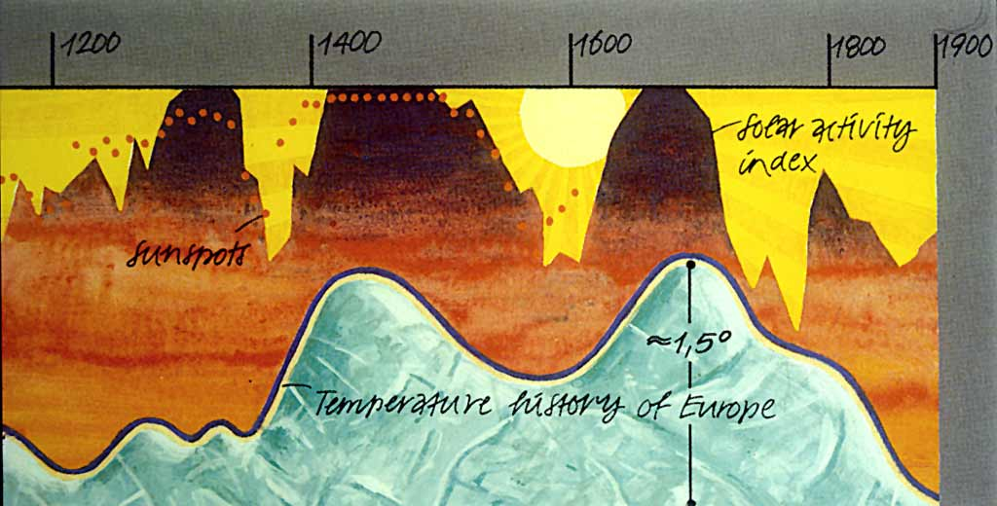

Slide 19
Flemish rotation, 17th century
Flax
Turnips
Oats undersown with red clover
… remains for four-five years
… before flax again

Slide 21
The average wheat yield
doubled to 20 bushels by the
late 18th century …
And there was an overall
increase in food production on
the traditional 3-course
wheat-oats-fallow rotation

Slide 22
So what happened? – a short history lesson
What happened to divert the course of agriculture from sustainability?

Slide 23
Scientific understanding
Justus von Liebig
1803-1873

Slide 24
BIG mistake!
Organic matter in the soil is vital to long-term soil integrity, plant health and productivity

Slide 25
Taking short cuts
Importing fertility (external inputs, increasing dependency and vulnerability)

Slide 26
The Chincha Isles, off the Peruvian coast
Notes:
The islands were once the residence of the Chincha people, but only a few remains are to be found today. Peru began the export of guano in 1840. Spain, not having recognized Peru's independence (it was not to do so until 1879), and desiring the guano profits, occupied the islands in April 1864, setting off the Chincha Islands War (1864–1866).

Slide 29
Fritz Haber
(1868-1934)
Two out of every five people now living
would not have been born if it
weren’t for artificial fertilisers made with
the Haber-Bosch process

Slide 31
Later achievements:
Chlorine gas
Zyklon B

Slide 32
Chlorine gas 1915
= the birth of chemical warfare

Slide 33
Later achievements:
Chlorine gas
Cyanide insecticide (Zyklon B)

Slide 35
Nitrogen plus hydrogen = ammonia NH₃
€
The energy comes from oil:
2 litres energy equivalent
for 1kg of fertiliser

Slide 36
Nitrogen plus hydrogen = ammonia NH₃
€
By 2030 the energy will be equivalent to
277 billion litres of diesel

Slide 37
The birth of modern intensive agriculture
Or: how fertilisers won the war

Slide 38
C₆H₂(NO₂)3CH₃
First World War 1914-18

Slide 39
C₆H₂(NO₂)3CH₃
First World War 1914-18

Slide 40
Second World War 1939-45

Slide 41
Input-intensive agriculture is characterised by:
Fertilisers
Herbicides
Pesticides
Ever-increasing mechanisation
ALL DEPENDENT ON WHAT?

Slide 42
Commercial agriculture is entirely dependent on oil

