Slide 1
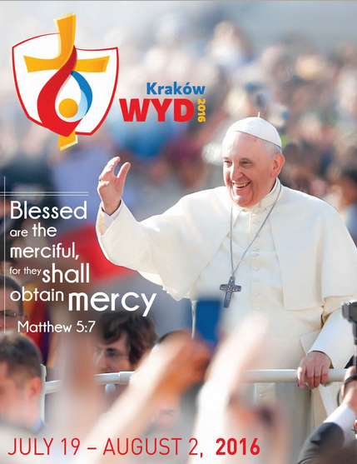
Blessed Are the Merciful

Slide 7
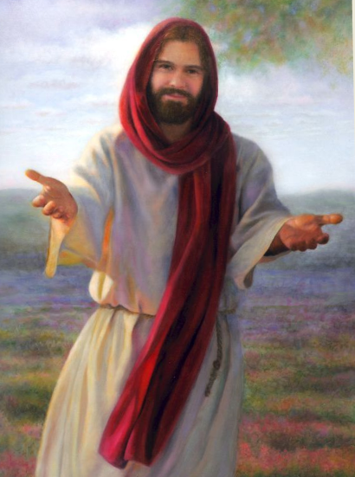

Slide 9
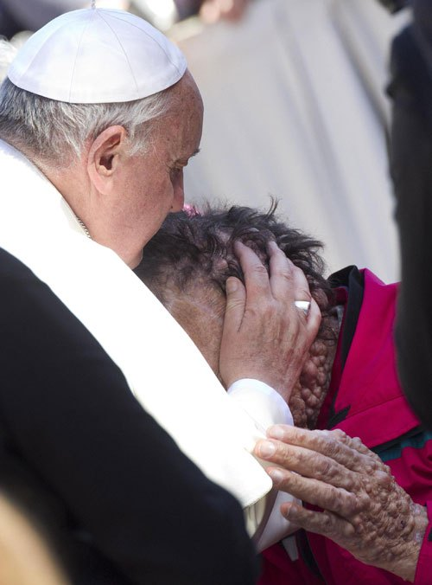

Slide 13
Mercy

Slide 22
For God loved the World so much He gave His only Son

Slide 25
Jesus is the
Lord!

Slide 34
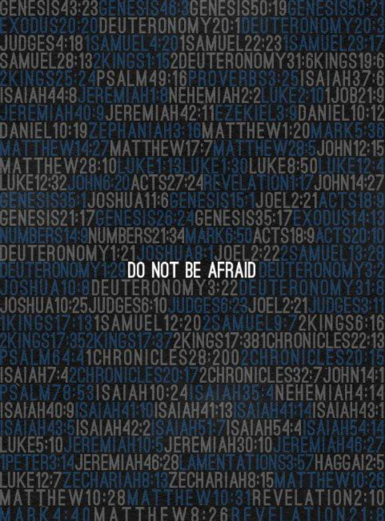

Slide 36
Give your cares to the Lord

Slide 37
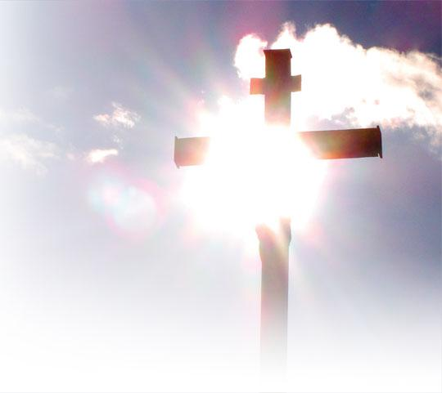

Slide 43
Blessed Are the Merciful

