Slide 1
Live the Message

Slide 2
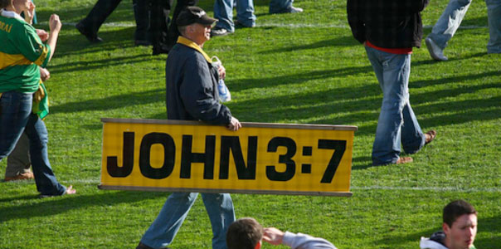
Proclaim the
Good News

Slide 3
LIFE

Slide 6
Walk in the Light

Slide 7
Brothers and Sisters

Slide 8
Live the Message

Slide 9
LIFE

Slide 15
Live the Message

Slide 18
Live the Message

Slide 19
Jesus
is
L I F E

Slide 20
Live the Message

Slide 22
LIFE

Slide 23
We Choose Life

Slide 26
Brothers & Sisters

Slide 27
Live the Message

Slide 28
LIFE

Slide 32
“A Peace the
World
cannot give”

Slide 34
Live the Message

Slide 35
Jesus
is
L I F E

Slide 37
Walk in the Light

Slide 39
P
E
A
C
E

Slide 42
Brothers & Sisters

Slide 43
Live the Message

Slide 44
LIFE

Slide 45
Jesus
is
L I F E

