Slide 1
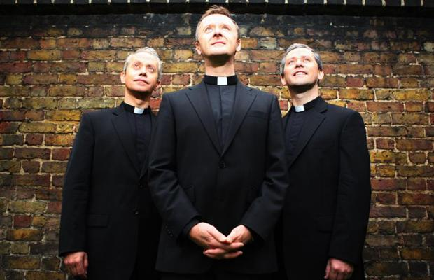
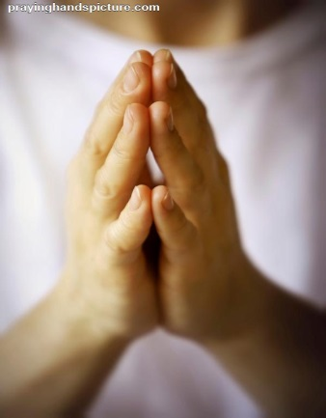
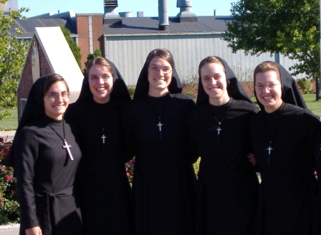
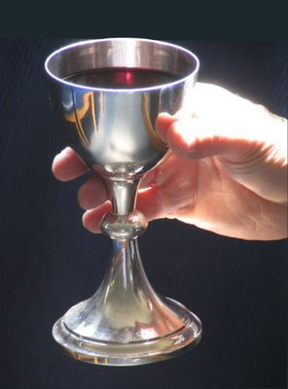
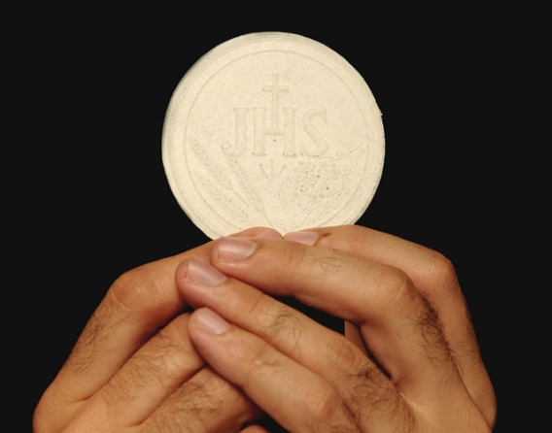
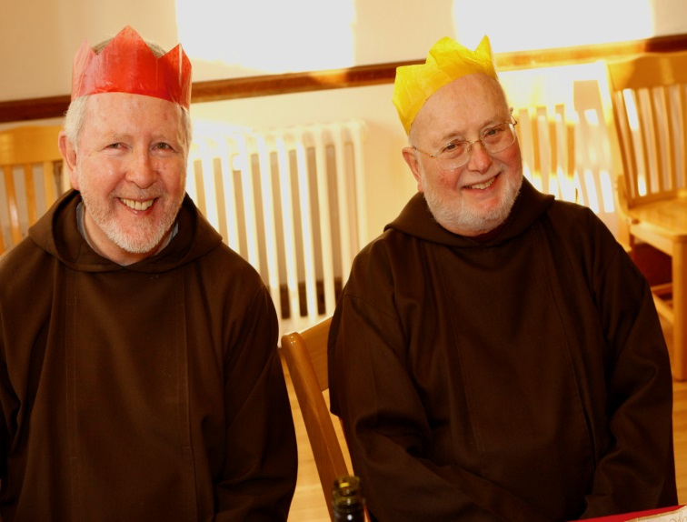
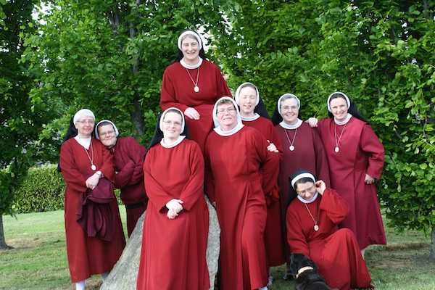
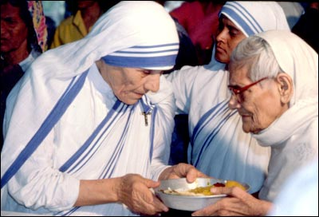

Slide 2
Year of Consecrated Life
It celebrates Religious Life and those who answer the Call to Vocation
Is your school linked to a diocese/Religious Order?
How much do you (or the younger students in your school) know about this link/Religious Order? (Founder, Vision, Mission)
Could you organise some form of celebration to mark this special Year?

Slide 3
Some ways to celebrate the Year of Consecrated Life
Invite representatives of the Religious Order associated with your school or those who live close by to:
Visit for a whole school celebration, such as a Prayer Service or Mass, where their contribution to the school and surrounding community is acknowledged and to pray for future vocations
Visit a class group who have prepared some questions to ask about life as a priest, brother, monk or nun or to view a presentation of your research
or YOU could:
Create some art work in light of what you have learned and display it in the school foyer/school grounds
Host coffee mornings where those in religious life are invited to the school on a termly basis so you can chat informally
Learn how to chant, pray using icons; whatever the way of life of the order may be, from the experts!

