Slide 1
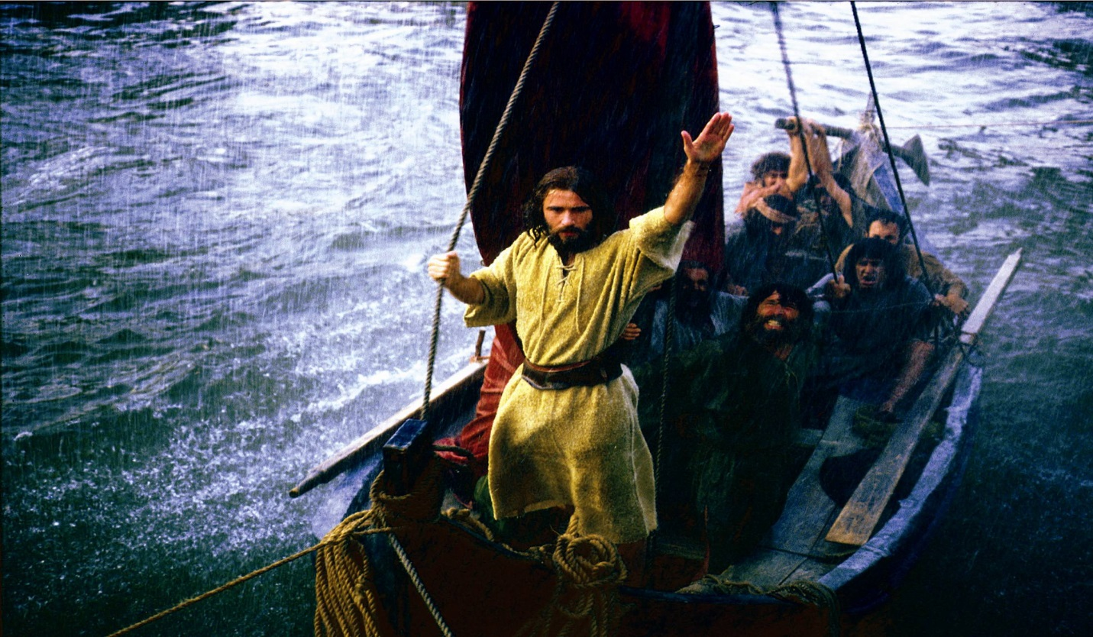
High is the heaven Deep is the sea

Slide 6
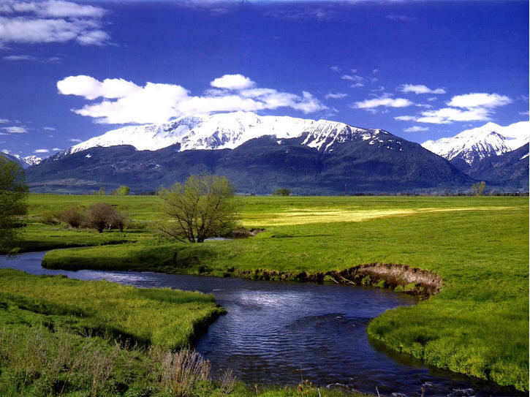

Slide 7
High is the heaven

Slide 8
Formed in your Spirit

Slide 10
And what of the heart
that yearns to be true

Slide 11
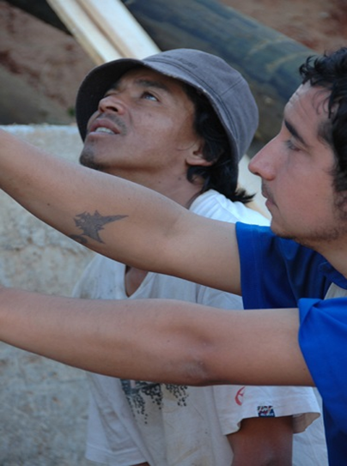
In care for another

Slide 12
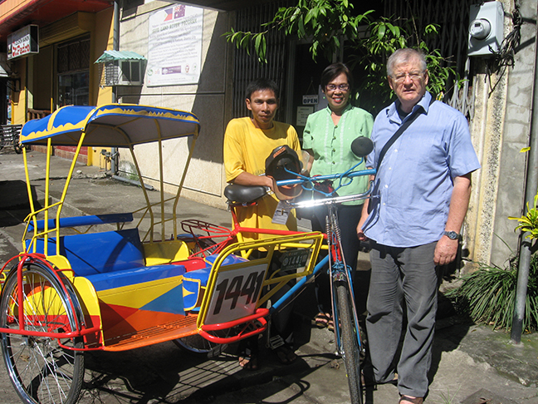
In love for the poor

Slide 14
A harvest of love
In earth’s lonely fields

Slide 15
High is the Heaven

Slide 16
Deep is the Sea

Slide 18
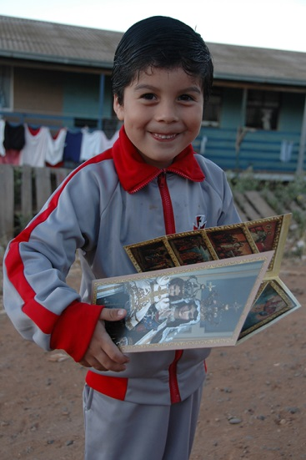

Slide 21
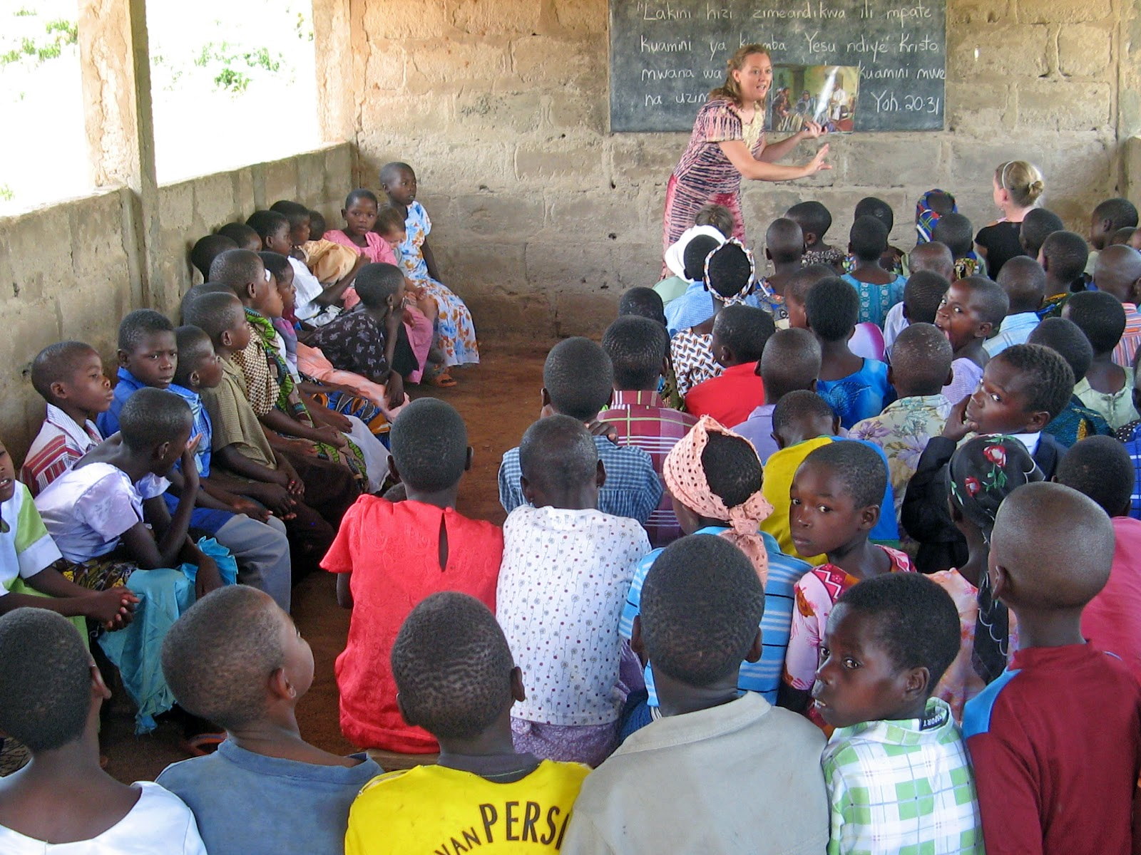

Slide 22
And what of the soul
That searches for peace

Slide 23
Wearied in toil

Slide 26
Where hope is revealed

Slide 27
And love is the sign

Slide 28
High is the Heaven

Slide 31
Formed in your Spirit

Slide 32
That we might reveal

Slide 34
Love is your dwelling

Slide 36
High is the Heaven

Slide 37
Deep is the sea

Slide 38
Formed in your Spirit

Slide 39
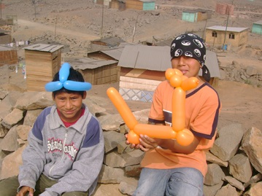

Slide 40
Love is your dwelling

Slide 41
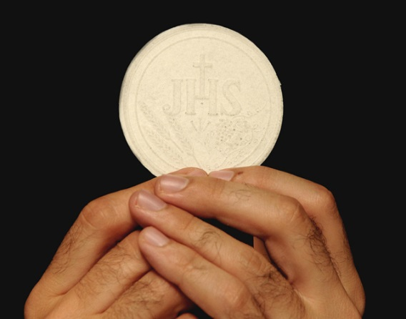

Slide 42
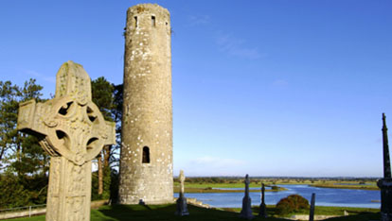

Slide 43
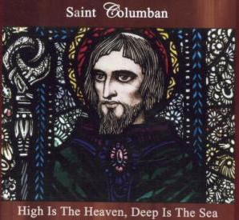
Columban of God
Your name we make known

