Slide 1

Trafficking in Persons
APT – Act to Prevent Trafficking
www.aptireland.org
facebook/APTacttopreventtrafficking

Slide 2
What is trafficking in Persons?
The trade in
and exploitation of
human beings
by criminals
to make money.
Human Trafficking threatens women, men & children

Slide 3

"Throughout our evolutionary story the universe constantly generates new life.
Anything which degrades that life violates the sacredness of all life".

Slide 4

“Human trafficking is an open wound on the body of contemporary society,
a scourge upon the body of Christ.
It is a crime against humanity.” Pope Francis 2013
APT – Act to Prevent Trafficking
www.aptireland.org

Slide 5
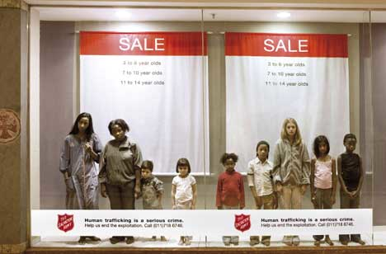
Different forms of human trafficking
Forced labour
Sale of human organs
Sexual exploitation
People are bought and sold as commodities

Slide 6
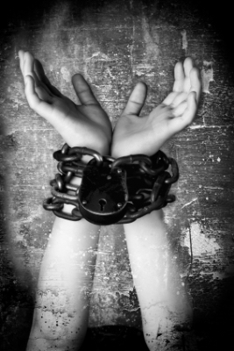
Smuggling Vs Trafficking
Smuggling of migrants and human trafficking both involve moving human persons for profit
Smuggled persons are left to their own devices on arrival
Trafficked persons are under the control of others

Slide 7
Roots of trafficking
PUSH
1. Poverty
2. Inequality
3. Violence
4. Prior sexual exploitation
5. Lack of awareness about this crime
PULL
1. Job opportunities
2. Promise of freedom/independence
3. Chance of a better quality of life
Notes:
Push and Pull factors
Push: Poverty (drives victims but also perpetrators – trafficking is highly lucrative), Inequality (in gender attitudes), Violence (domestic/civil), Prior sexual exploitation (former victims may be re-trafficked, their vulnerability may be increased due to traumatisation, normalisation of sexual exploitation), Lack of awareness about the prevalence of this crime and the risks of becoming a victim through deception, fraud, or grooming.
Pull: In cases of trafficking from poorer to richer countries there can be a perceived opportunity to make a lot of money and improve your quality of life.

Slide 8
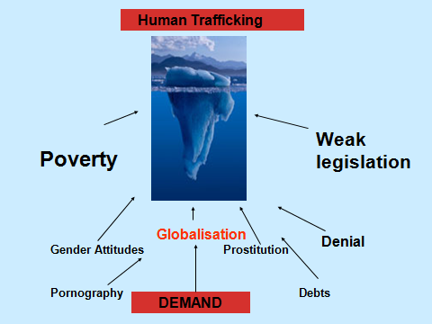

Slide 9
Key Facts
Human Trafficking is one of the top 3 most profitable illegal trades
Fastest growing illegal trade
27 million people per year globally
100$ billion per year globally – more than Google, Nike and Starbucks combined
Ireland has been identified as a source, transit and destination country for trafficking.
Notes:
Top 3 illegal trades – arms, drugs, humans. Accounts vary as to the exact order.
One of the reasons it’s the fastest growing illegal trade is because, unlike drugs or arms, traffickers can make money selling their victims over and over again.
US TIP Report 2014 – Ireland a source, transit and destination country.

Slide 10
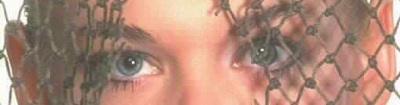
Who is trafficked?
Particularly vulnerable are:
Women and children
People lacking money/opportunities
People wishing to improve their lives, from all backgrounds, races, and classes
Unskilled labourers
Undocumented migrants
Oppressed ethnic/cultural groups
Notes:
These are the most vulnerable groups but it’s important to remember that trafficking can happen to ANYONE of any gender, age, nationality, race, socio-economic background.

Slide 11
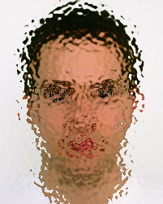
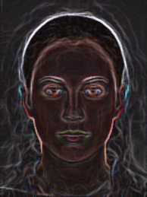
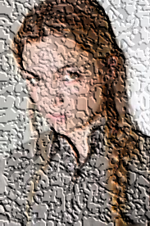
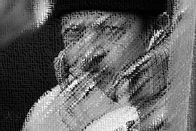
Who are the traffickers?
A trafficker has many faces –
Male and female
Members of organised gangs
Boyfriends
Family and friends

Slide 12
How are persons trafficked?
Traffickers recruit through –
Fake job adverts – care work, modeling,
dancing, hotel/bar work/study/travel
Casual acquaintance/‘friends’
Grooming – often online

Slide 13
Extracts from profiles
Julia
Aged 17, was given clothes and boots and a bag of condoms and told to do anything that clients wanted. Forced to have sex with a minimum of four men per night.
Kiky
From Nigeria, was held in total captivity in a house in Ireland for two years.
Lydia
From Poland, was chaperoned daily to a brothel in Italy and her movements were controlled. When she returned each day, her trafficker raped her in the apartment. She was subsequently brought to Ireland and forced into prostitution.
Notes:
Names have been changed to protect identity

Slide 14
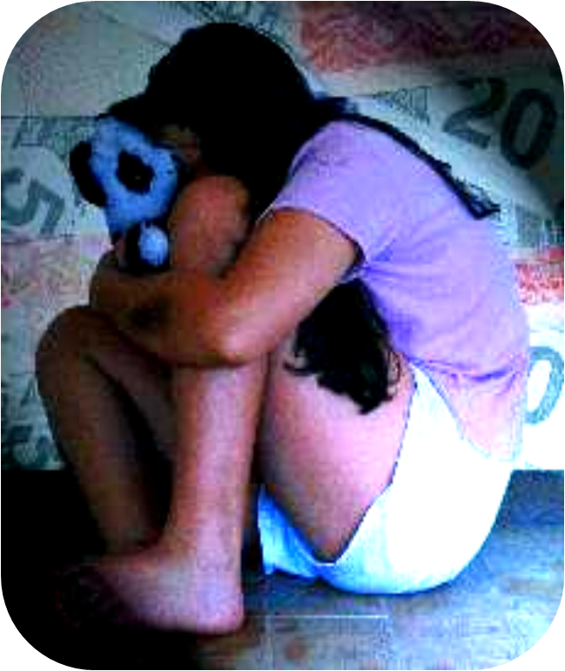
Why don’t trafficked persons escape?
Violence – rape and beatings
  force them to comply
Threats/blackmail – against their families back home
Debt servitude – held in bondage and responsible to trafficker

Slide 15
Some statistics…
75% of all trafficking victims globally are women and girls
76% of victims in Europe are trafficked for sexual
exploitation (this figure is roughly the same for Ireland)
Up to 97% of women in indoor prostitution in Ireland are
migrant women (3-13% are Irish)
There are at least 1,000 women (and girls) in indoor
prostitution at any one time in Ireland.
Notes:
Sources:
Stat. 1: UN Office of Drugs and Crime, Global Report on TIP, 2012
Stat. 2: EUROPOL Trafficking in Human Beings in EU, 2011
Stat. 3 & 4: StopTraffick.ie Learning Toolkit (still tracking down original source for this!)

Slide 16
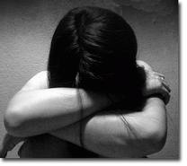
Effects on trafficked persons
Lack of trust/Anger/Fear
Insecurity/Confusion
Shame/Guilt
Depression/Helplessness
Post-traumatic stress disorder –
e.g. flashbacks

Slide 17
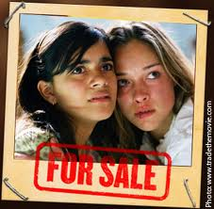
Why should we care?
Trafficking –
Is the most shocking form of
human rights abuse and modern
day slavery
Is happening now, here, there, and
wherever you are
It could happen to someone you
know

Slide 18
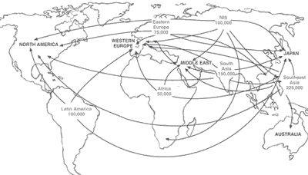
Trafficking Worldwide
Approximately 27 million per year
Notes:
18
Some countries of Origin : VERY HIGH LEVELS = Belarus, Moldova, Russia, Ukraine, Albania, Bulgaria, Lithuania, Romania, China, Thailand, Nigeria.
Bangladesh, India, Nepal, Pakistan, Latvia, Burma, Cambodia, Morocco, Colombia, Mexico, Brazil, Vietnam.
Some countries of TRANSIT : VERY HIGH LEVELS = Albania, Bulgaria, Hungary, Poland, Italy, Thailand.
Bosnia – Herzegovina, Czech Republic, Kosovo, Yugoslavia, Macedonia, Romania, Serbia, Montenegro, Slovakia, Ukraine, Burma, Turkey, Belgium, France, Germany, Greece.
Some countries of DESTINATION : VERY HIGH LEVELS= Belgium, Germany, Greece, Italy, Netherlands, Israel, Turkey, Japan, Thailand, US.
UK, Ireland, Australia, Canada, India, Pakistan, Saudi Arabia, Kosovo, Poland, China, Taiwan, UAE, France, Spain, Switzerland, Bosnia, Austria, Denmark, Czech Republic, Cambodia.

Slide 19
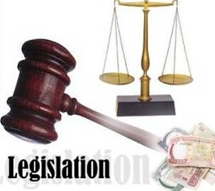
International Legislation to combat trafficking
1. The Palermo Protocol
and
2. The Council of Europe Convention
Notes:
Important to point out that there are others: EU Directive on Preventing and Combating Trafficking in Human Beings, 2011

Slide 20
UN Palermo Protocol, 2000
ACTION
‘the recruitment, transportation, transfer, harbouring or receipt of persons’
MEANS
‘threat or use of force or other forms of coercion, of abduction, of fraud, of deception, of the abuse of power, or of giving or receiving payments or benefits to achieve the consent of a person having control over another person’
PURPOSE
Exploitation – including prostitution or other forms of sexual exploitation
Notes:
As defined by the UN Protocol to Prevent, Suppress and Punish Trafficking in Persons, especially Women and Children, Palermo 2000. These three elements are necessary for human trafficking to occur. In the case of children, the MEANS is not necessary; children cannot consent to their own exploitation. A child in prostitution is always a case of human trafficking.

Slide 21

Council of Europe Convention on Action Against Trafficking in Human Beings 2005
A 'reflection period' of at least 30 days
Safe and secure housing
Psychological and emergency medical assistance
Information in a language the trafficked person can understand
Renewable residence permits to trafficked persons
Compensation for the abuses suffered

Slide 22
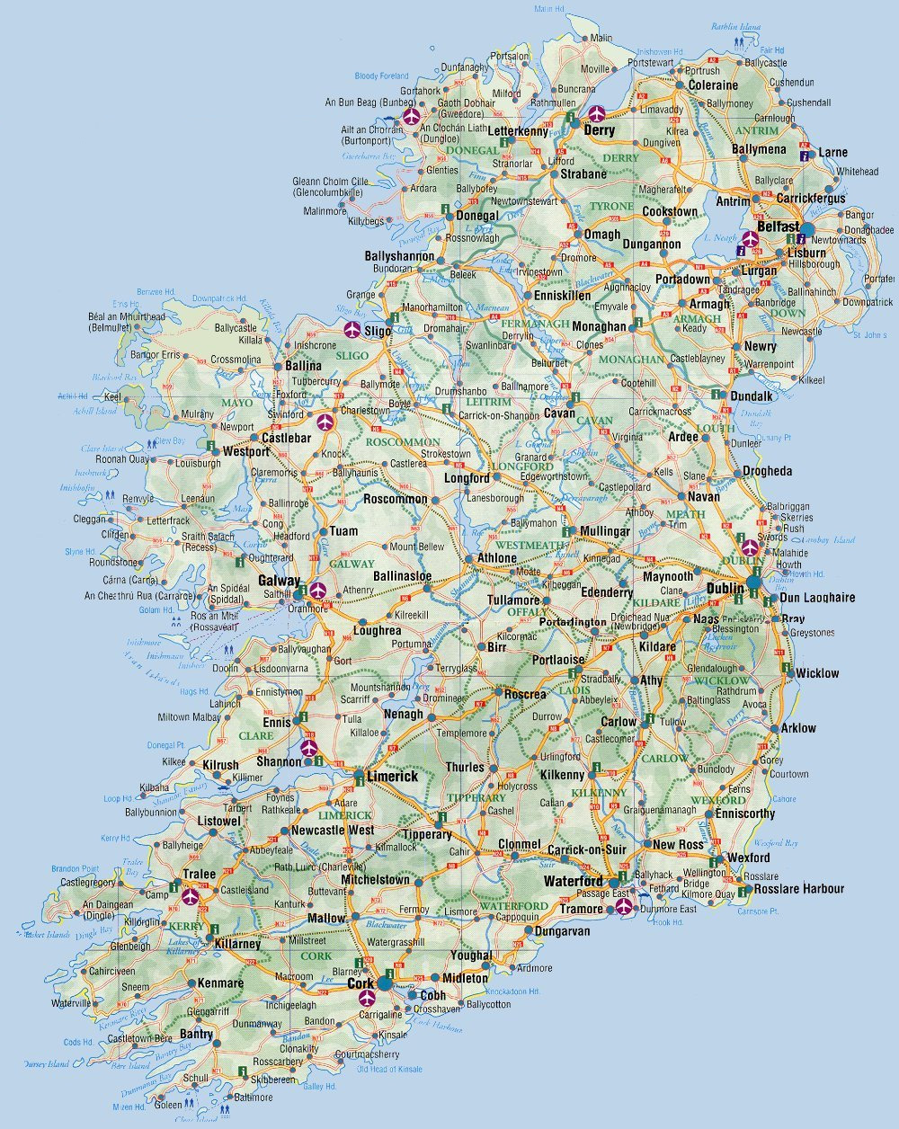
Ireland: current legal stance
The Criminal Law (Human Trafficking) Act 2008
PREVENT Trafficking - PROSECUTE Traffickers - PROTECT Victims
It is a criminal offence to solicit or importune, in any place, for the purpose of prostitution, a person whom one knows to have been trafficked.
The victim is allowed 60 days of recovery.
Administrative procedures in place for protection of victim.
Anti-Human Trafficking Unit (AHTU) models best practice for protection of victim.
http://www.justice.ie

Slide 23

Trafficking in Persons
WHAT
CAN
WE
DO?

Slide 24
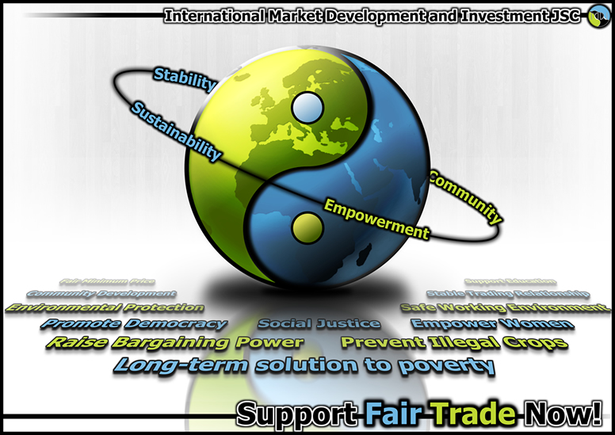
WHAT CAN WE DO?
Become informed of human trafficking
Report any suspicious events, happenings in your local area to local police
Encourage people to talk to each other about this modern day slavery
Promote non violence in all situations
Respect the dignity of each person
Organise a speaker to your relevant groups
Promote fair trade and check retailers supply chain

Slide 25
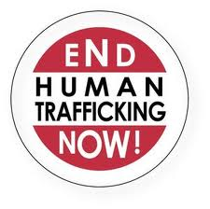
List of Resources
Websites
http://www.aptireland.org
http://www.ruhama.ie
http://www.blueblindfold.gov.ie
http://www.immigrantcouncil.ie
http://www.turnofftheredlight.ie
http://www.tirzah.ie
International Organisations
http://www.coatnet.org - Christian Organisations Against Trafficking in Human Beings
http://www.antislavery.org - Anti Slavery International
http://www.gaatw.net - Global Alliance Against Traffic in Women (GAATW)
http://www.catinternational.org - The Coalition Against Trafficking in Women (CATW) International
http://www.renate-europe.net - Religious in Europe Networking Against Trafficking and Exploitation

Slide 26
