Slide 1
Extraordinary Jubilee Year of Mercy 8 December 2015 – 20 November 2016

Slide 2
What is a holy year?
Every 25 years the Pope announces a ‘Holy Year’. Holy Years include special celebrations and pilgrimages. They offer special opportunities to experience God's grace through the sacraments. This will be only the 29th Holy Year in the Church since the tradition started more than 700 years ago.

Slide 3
The Holy Year of Mercy, taking place this year, is an Extraordinary Holy Year.
It is only the third Extraordinary Holy Year ever.
The last extraordinary Holy Year was called in 1983 by Pope John Paul II to mark the 1,950 years after the death of Jesus.

Slide 4
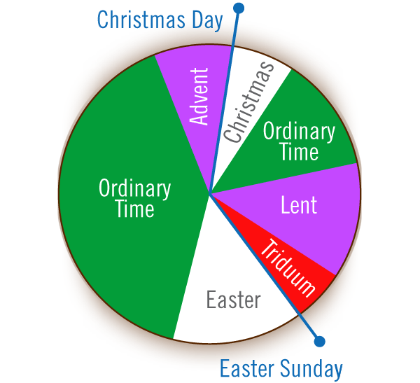
The Extraordinary Jubilee Year of Mercy will begin on December 8th this year and conclude on November 20th 2016; from the second week of Advent, the feast of the Immaculate Conception to the last feast of the Liturgical Year (the Church’s calendar), the feast of Christ the King.

Slide 5
The theme for the Holy Year is: “Be merciful, just as your Father is merciful” (Lk. 6:36)

Slide 6
What is mercy?
compassion
forgiveness
understanding
mercy
empathy
love
generosity
kindness
inclusivity

Slide 7
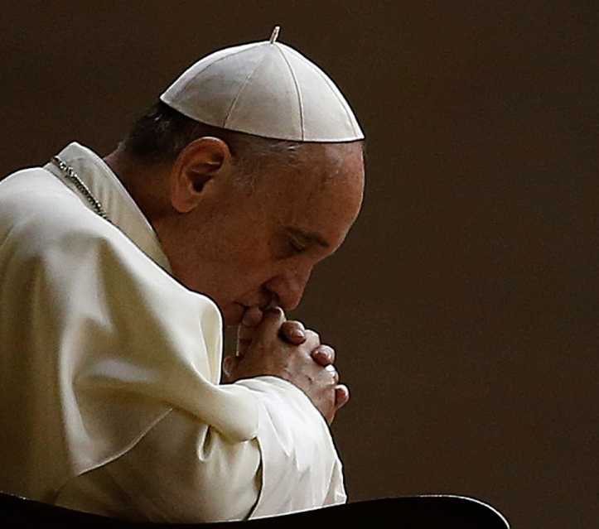
Pope Francis asks us to be more merciful towards each other and that this extraordinary Holy Year is an opportunity to rediscover the need to be forgiving and generous.

Slide 8
This is the logo for the Year of Mercy.
What do you see?

Slide 9
At the centre we see Jesus, carrying a person, as a shepherd might carry a sheep.
In carrying a person on his shoulders Jesus reminds us how close we are to God’s love. The person represents all of us.
Jesus, just like the Good Shepherd, cares for everyone.
Does this image remind you of other pictures of Jesus you have seen?

Slide 10
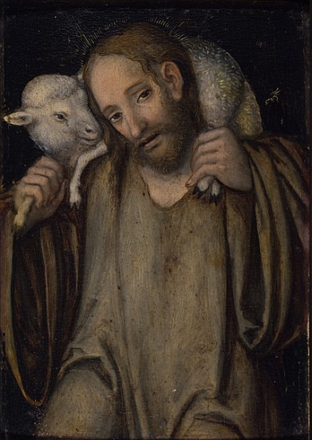
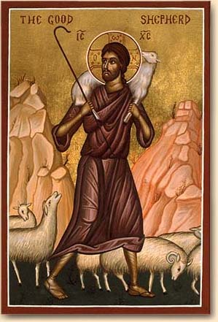
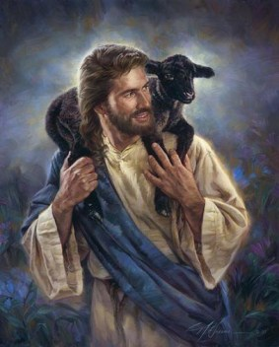
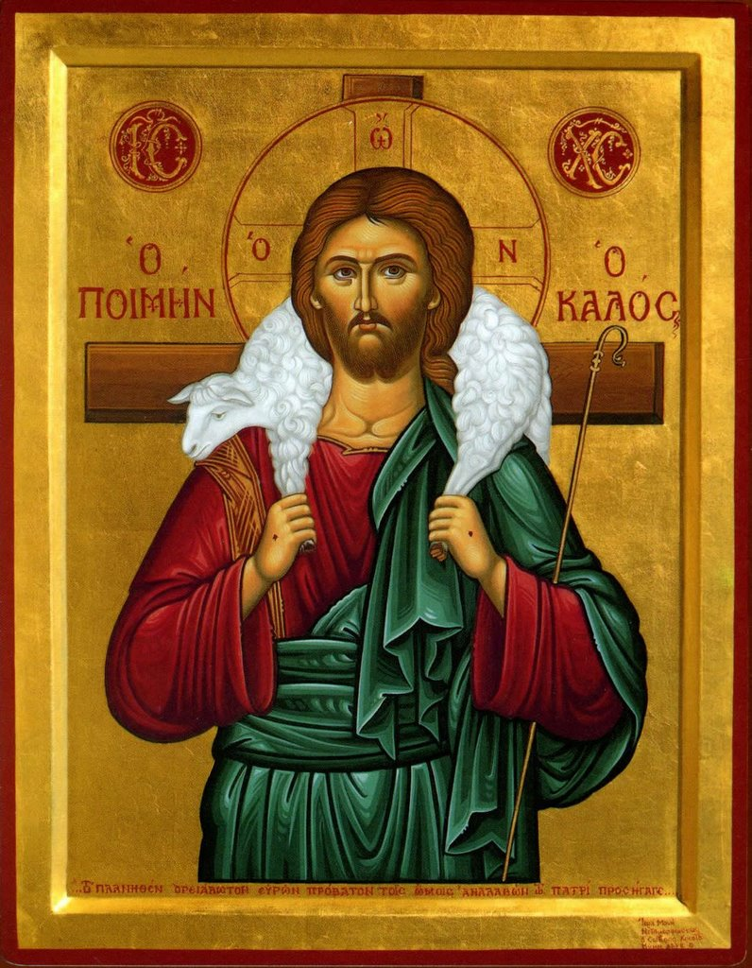
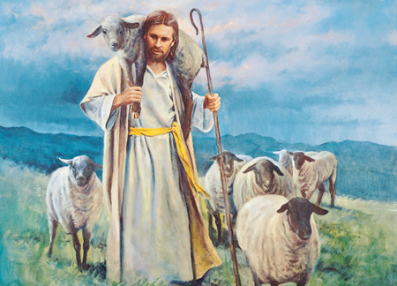
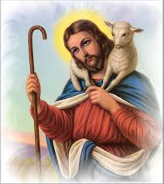
The Good Shepherd

Slide 11
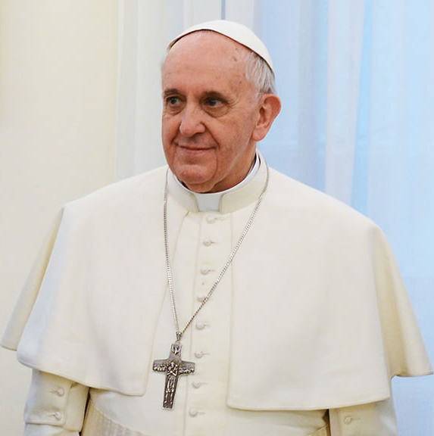
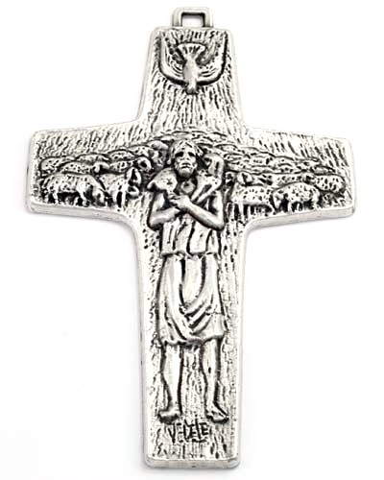
Pope Francis wears a cross. The cross contains an image of Jesus as the Good Shepherd.

Slide 12
In the logo, Jesus and the person are sharing an eye.
This reminds us that Jesus sees life through our human eyes and we pray that we may see ourselves and others through the merciful eyes of Jesus.
Jesus’ body is positioned against the cross. Notice the wounds on Jesus’ hands and feet.
The logo was designed by Fr Marko Rupnik SJ.

Slide 13
Jesus teaches us the Great Commandment
‘Love the Lord your God with all your heart, with all your soul, and with all your mind.’ This is the greatest and most important commandment. The second most important commandment is like it: ‘Love your neighbour as yourself.’
(Mt. 23:37-39)

Slide 14
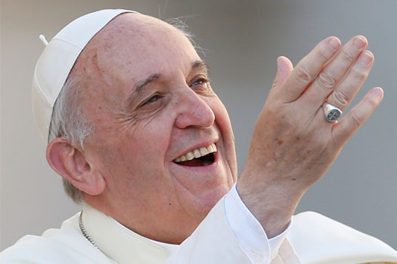
Pope Francis said during his general audience on November 18th 2015,
“On the threshold of the Year of Mercy, I want to reflect today on the meaning of the Holy Door,” he said. “It's a door that opens in the Church in order to reach out to those who for many reasons are far away.”

Slide 15
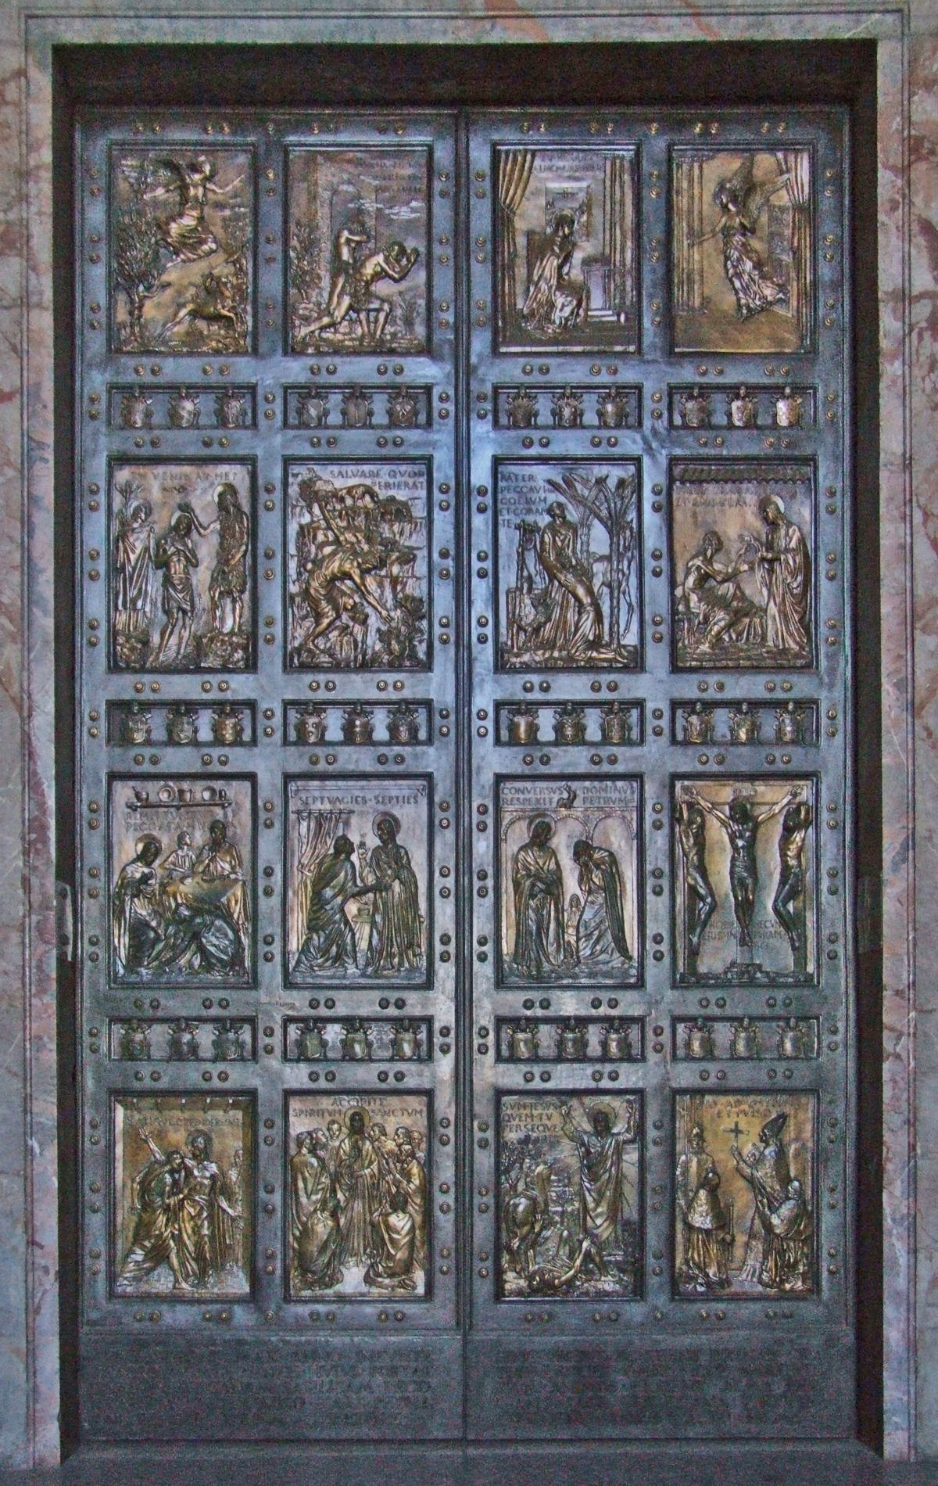
Holy Door of Mercy
On December 8th one of the entrances to St. Peter’s Basilica, which is known as the Holy Door and normally bricked up, is opened so pilgrims can pass through it.
The panels on the door are images from Holy Scripture.
This Holy Door will be opened with special keys by Pope Francis.
The Holy Father invites us all to open our doors “to meet Jesus, who waits for us patiently, and wants to bring us his blessing and friendship.”

Slide 16
Watch the following video to see how the preparations are going for the opening of the Holy Door.
http://irishcatholic.ie/video/holy-door-st-peters-basilica-unveiled

Slide 17
The Holy Doors of Rome’s other basilicas will also be opened. In fact many doors, right throughout the world will be opened during this special year.
The doors are symbols of our faith journey. The rite of opening these special doors helps us to understand that there are “extraordinary paths” we can follow to share God’s mercy.

Slide 18
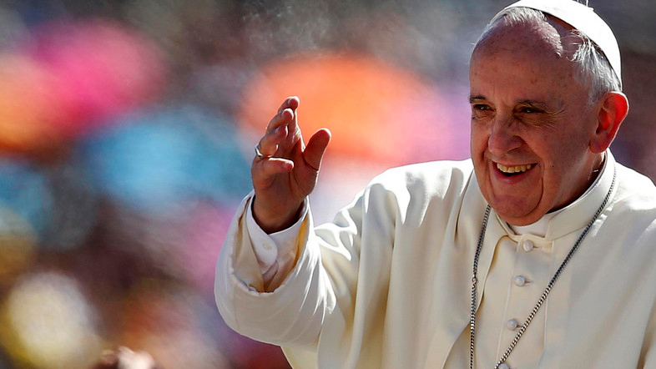
“The Church is the home that accepts everyone and refuses no one … the greater the sin, the greater the love that the Church should show towards those who convert.”

Slide 19
Further information available on
http://stpetersbasilica.info/Interior/HolyDoor/HolyDoor.htm
http://www.catholicbishops.ie/2015/11/11/resources-jubilee-mercy-8-december-2015-20-november-2016/
http://education.dublindiocese.ie/category/religious-education/primary/
http://litmus.dublindiocese.ie/2015/10/jubilee-of-mercy-20152016-ideas-for-your-parish/

