Slide 1
What I Have Learned In Life…

Slide 2
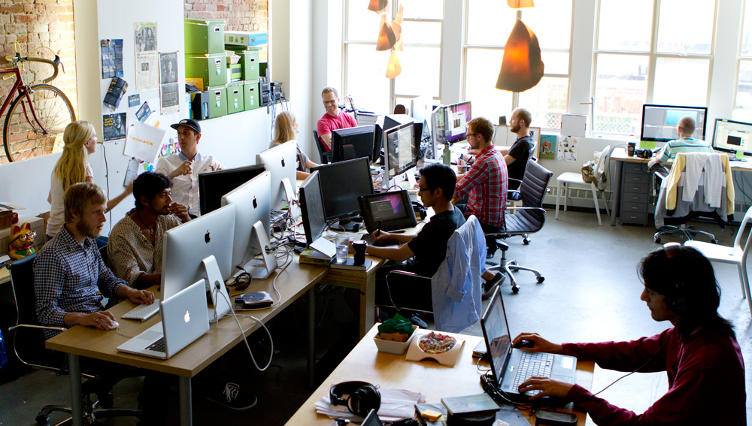
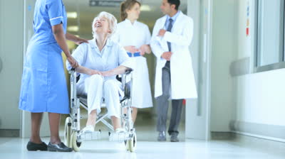
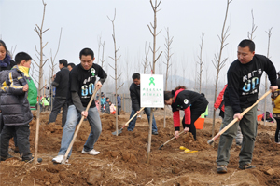
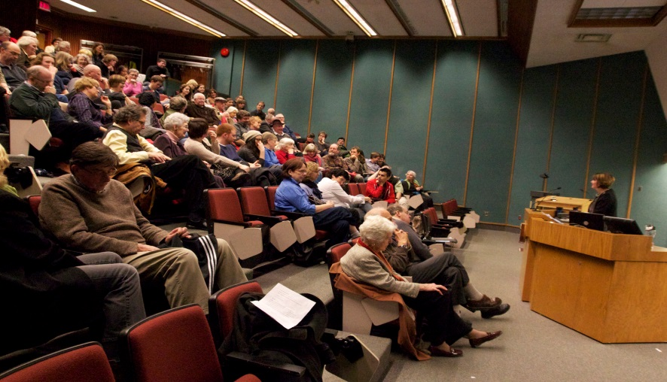
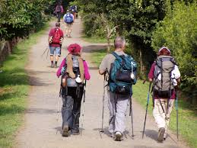
I’ve learned… That the easiest way for me to grow as a person is to surround myself with people smarter than I am.

Slide 3
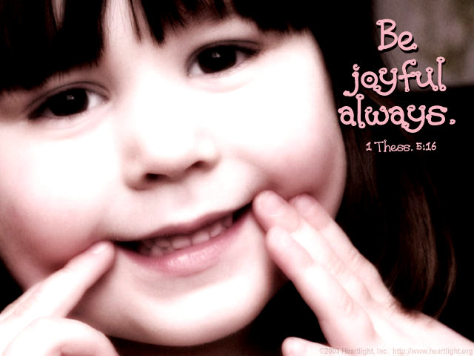
I’ve learned…
That everyone you meet deserves to be greeted with a smile.

Slide 4
I’ve learned…
That love, not time, heals all wounds.

Slide 5
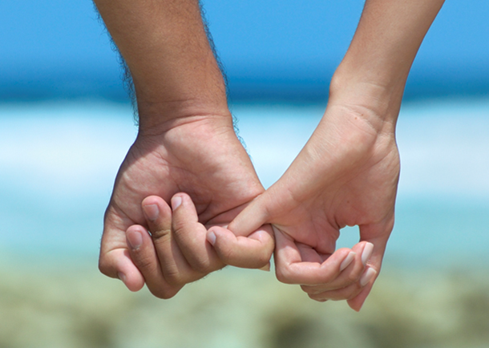
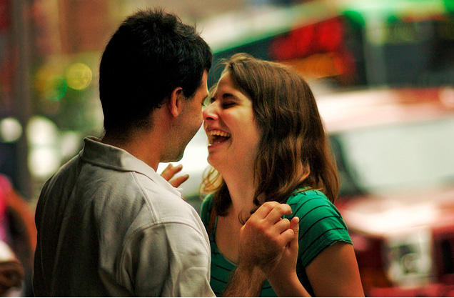
I’ve learned…
That no one is perfect…
.
until you fall
in love
with them

Slide 6
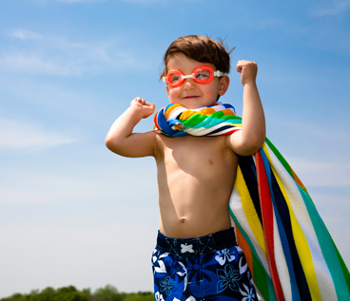
I’ve learned… that life is tough
But I’m TOUGHER

Slide 7
I’ve learned…
That opportunities are never lost;
someone else will take the ones you miss.

Slide 8
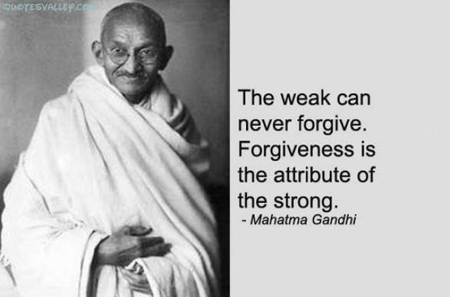
I’ve learned…
That when you harbour bitterness,
happiness will dock elsewhere.

Slide 9
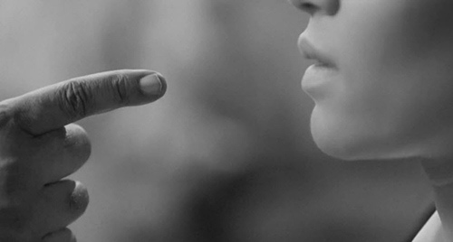
I’ve learned…
That one should always keep one’s words both soft and tender…
because tomorrow one may have to eat them.

Slide 10
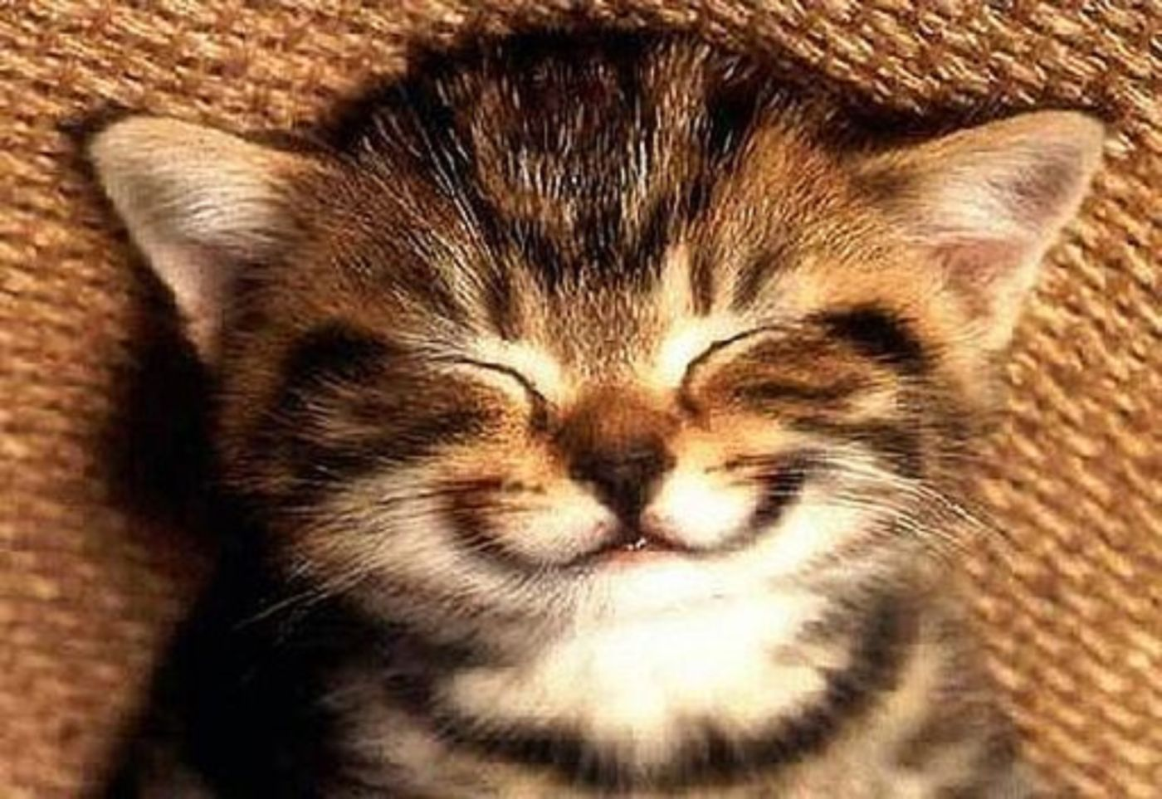
I’ve learned…
That a smile is an inexpensive way to improve your looks.

Slide 11
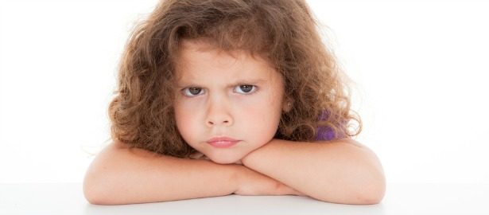
I’ve learned…
That I can’t choose the way I feel, but I can choose what I do about it.

Slide 12
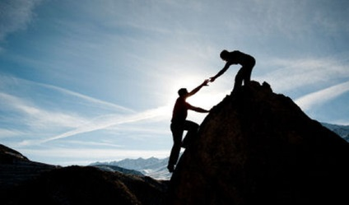
I’ve learned…
That everyone wants to live at the top of the mountain, but all the happiness and growth occurs while you’re climbing it.

Slide 13
I’ve learned…
That it’s best to give advice
in only two circumstances;
when it is requested and
when it is a
life threatening situation.

Slide 14
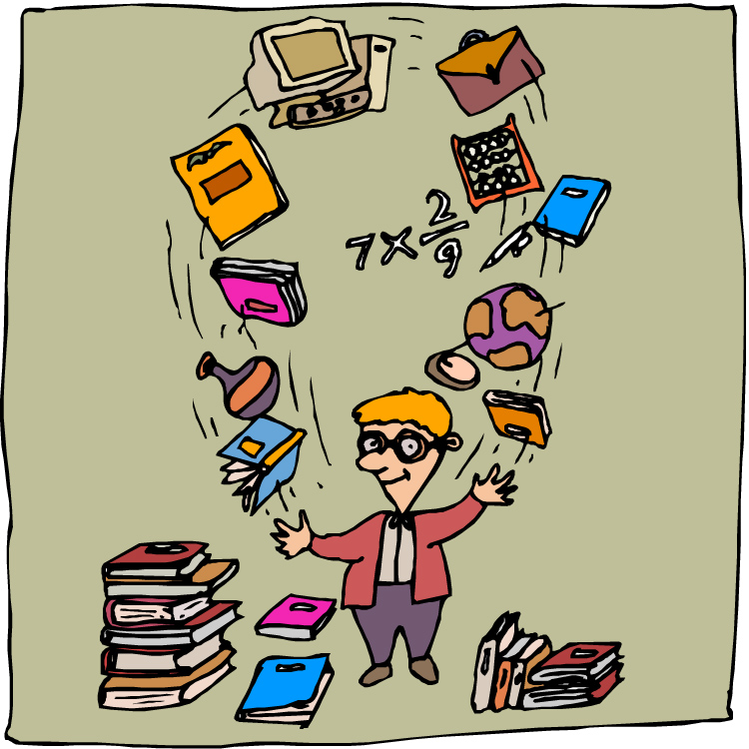
I’ve learned…
The less time
I have to
work with,
the more things
I get done.

Slide 15
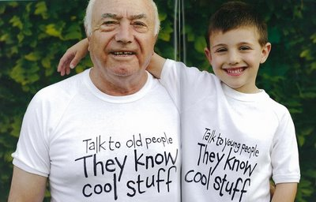
I’ve learned…
That the best classroom in the world is at the feet of an older person.

Slide 16
I’ve learned…
That just one person
saying to me,
“You’ve made my day!”
makes my day.

Slide 17
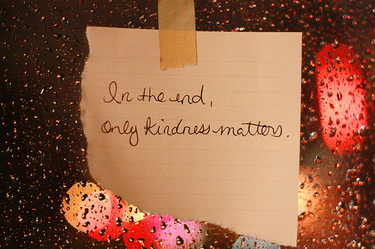
I’ve learned…
That being kind is more important than being right.

Slide 18
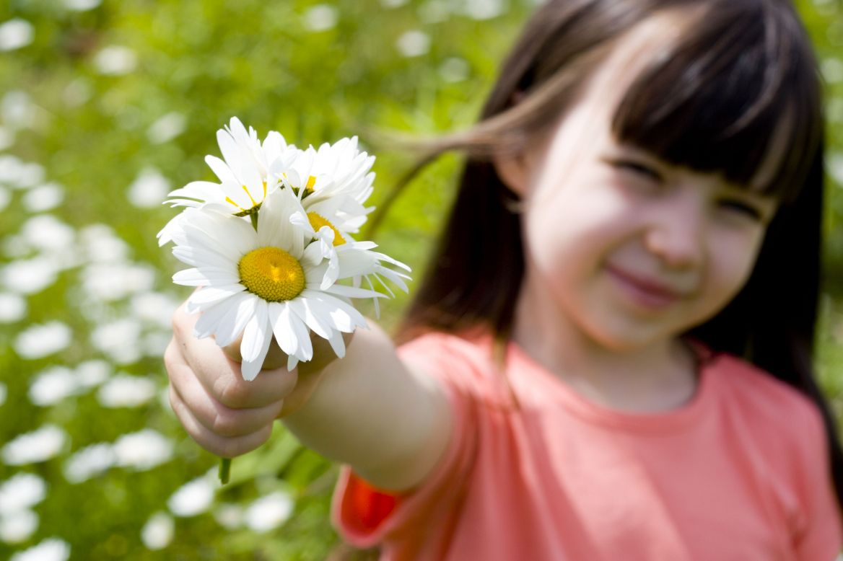
I’ve learned…
That you should never say ‘no’
to a gift from a child.

Slide 19
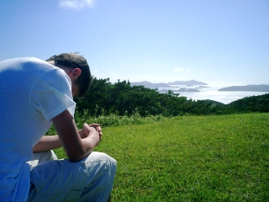
I’ve learned…
That I can always pray for someone when I don’t have the strength to help them in some other way.

Slide 20
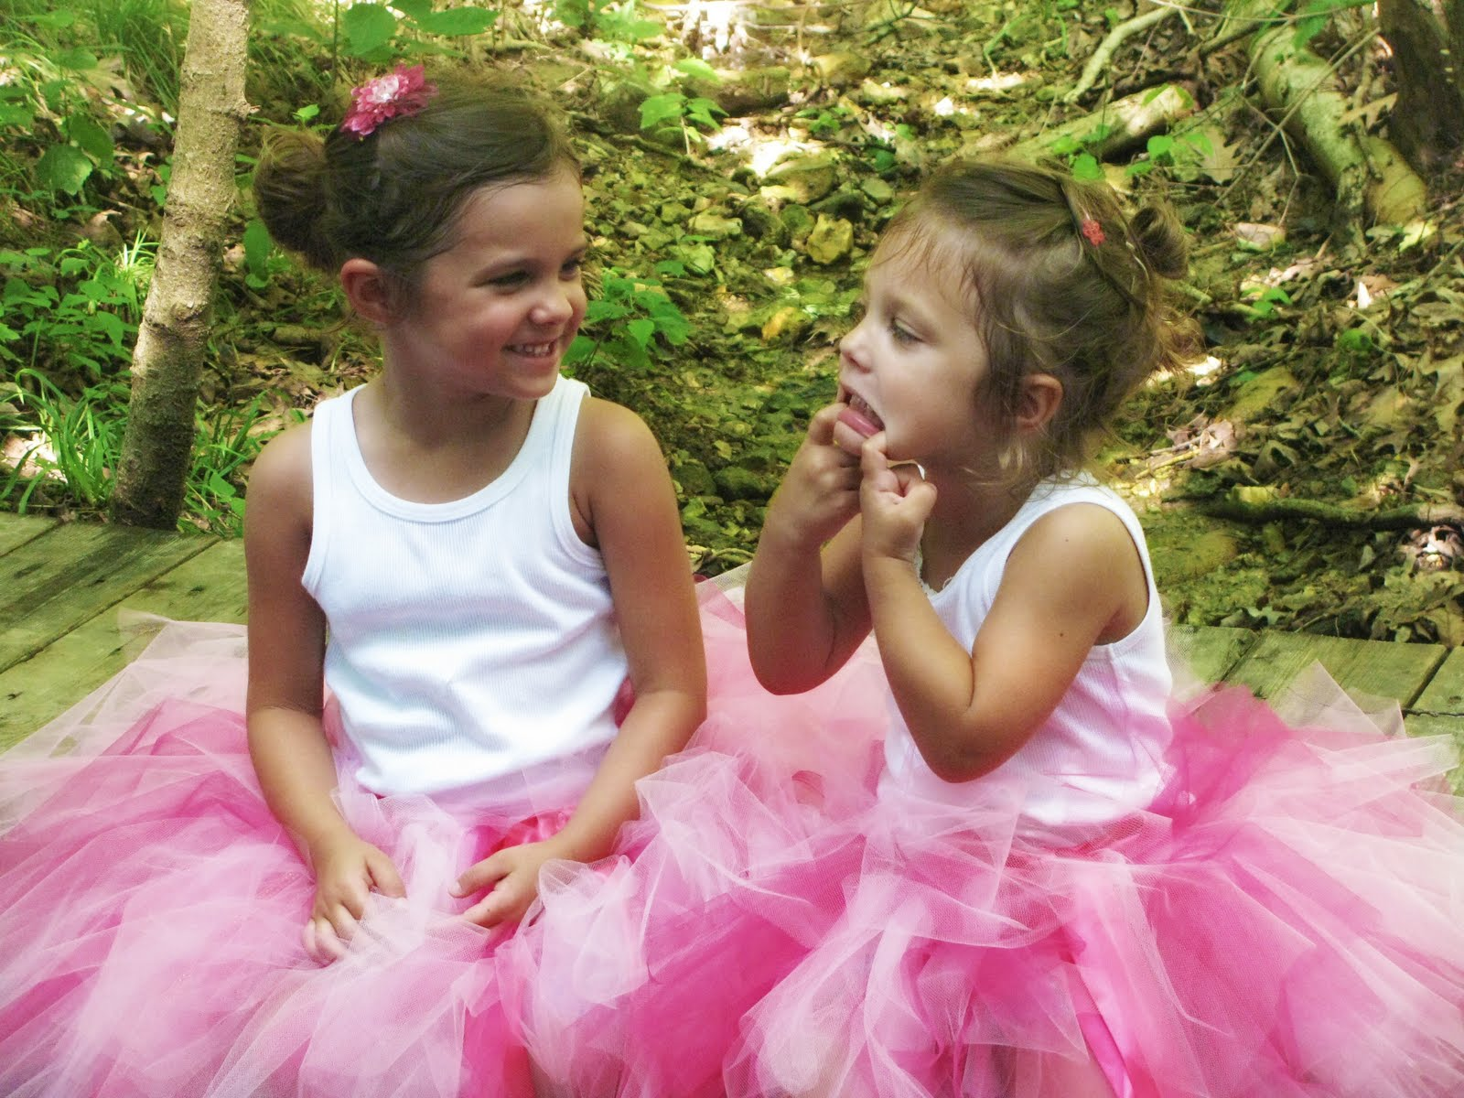
I’ve learned…
That no matter how serious your life requires you to be, everyone needs a friend to act goofy with.

Slide 21
I’ve
learned…
That sometimes
all a person
needs, is a
hand to
hold
…and a heart to understand.

Slide 22
I’ve I’ve learned…
That sometimes
all a person needs, is a hand to hold and a heart to understand.

Slide 23
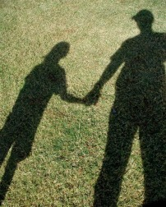
I’ve learned…
That simple walks
with my father on summer evenings
when I was a child
did wonders
for me as an adult.

Slide 24
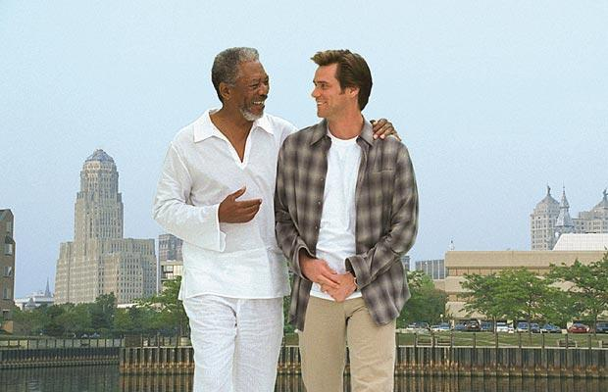
I’ve learned…
That we should be glad God doesn’t give us everything we ask for.

Slide 25
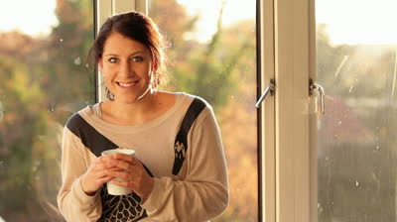
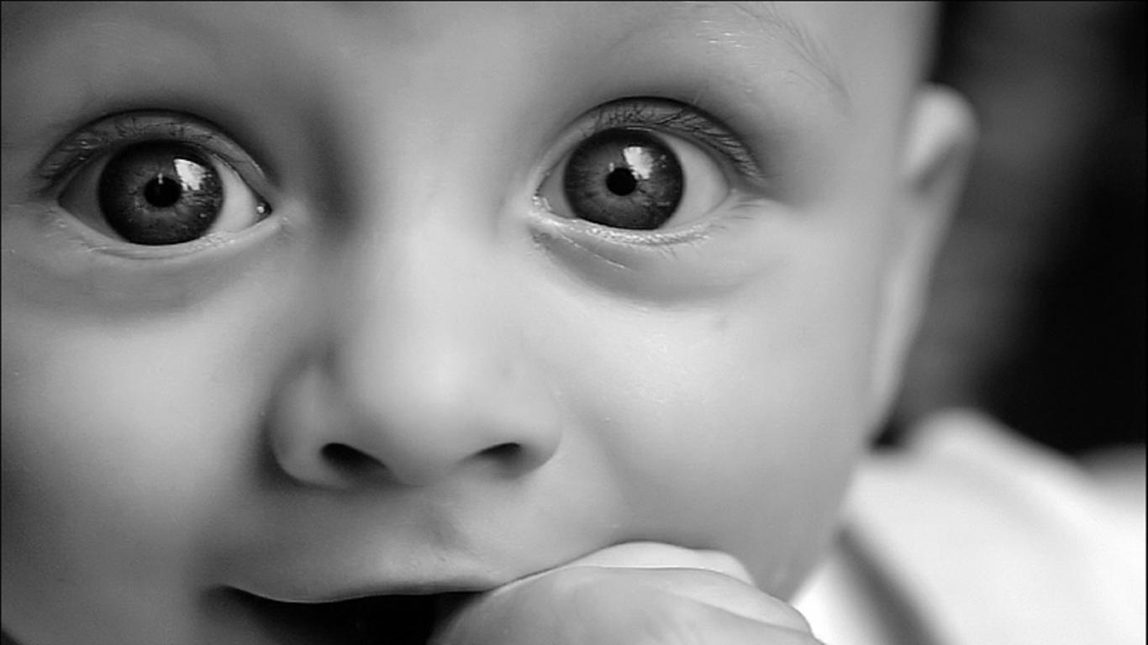
I’ve learned…
That it’s those small
daily happenings that
make life so spectacular.

Slide 26
I’ve learned…
That under everyone’s hard shell is someone who
wants to be appreciated and loved.

Slide 27
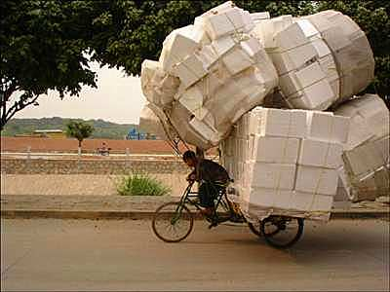
I’ve learned…
That the Lord didn’t do it all in one day.
What makes me think I can?

Slide 28
And last but not least…
“I shall pass through this world but once,
any good therefore, that I could do,
or any act of kindness that I could show
to any human being, let me do it now,
let me not forget it,
for I shall not pass this way again.”

