Slide 1
The Holocaust
How did the Nazis treat German Jews before the war?

Slide 2
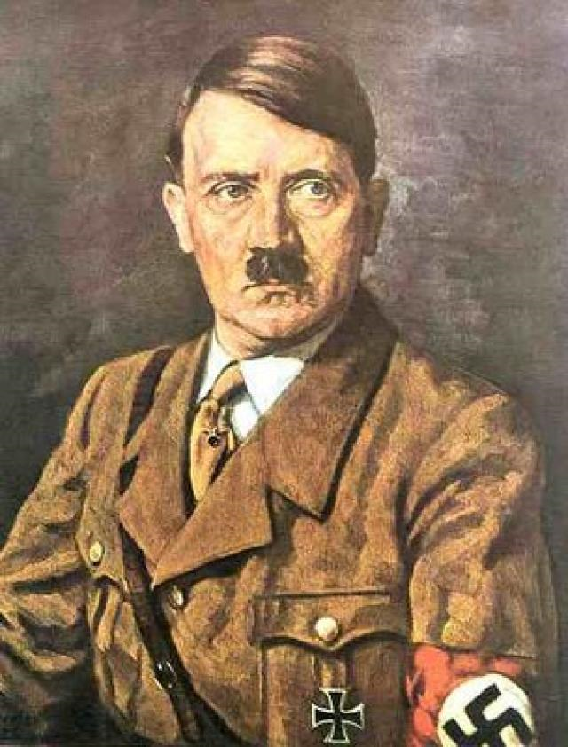
Historians are not sure exactly what Hitler’s long term plans for the Jews were. It seems likely that Hitler didn’t know either. But he didn’t wait long before making a start on his anti-Semitic policies once he became Chancellor of Germany in 1933. These policies were mild compared to what the Nazis would do later. Perhaps Hitler was uncertain how the policies would affect he German economy, and he may have been worried about the opinion of foreign governments if his measures were too violent. To begin with then, Hitler moved cautiously.

Slide 3
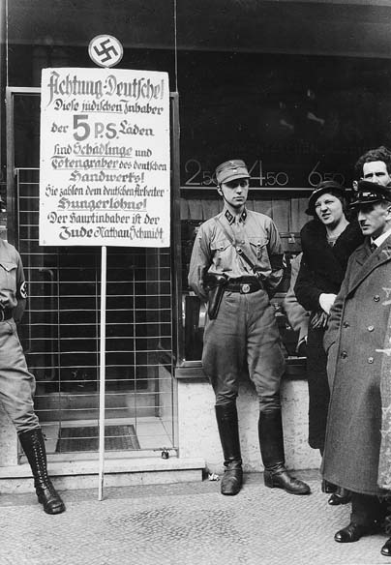
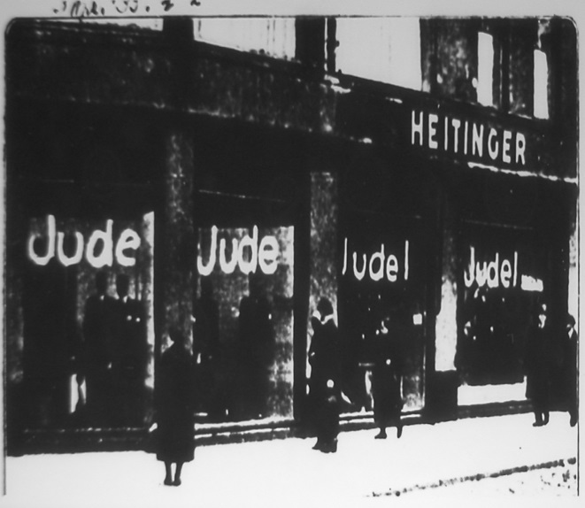
Boycott
On April 1st 1933, the Nazis called on Germans to boycott Jewish businesses and professionals such as dentists, lawyers and doctors. Boycott means to refuse to buy from, or use the services of a particular group – in this case, the German Jews. However, the boycott only lasted one day. Jews were also banned from working for the government.
Some Jews - with the Nazi governments approval – decided to leave Germany. During 1933 and 1934, 60,000 out of Germany’s 500,000 Jews left for good. It wasn’t easy however to find countries willing to take them in. Nonetheless, by the time Hitler stopped Jews from leaving Germany in 1941, 75% had left the country.

Slide 4
The Nuremberg Laws
Many fanatical Nazis were unhappy with the slow progress of the measures against the Jews. They wanted harsher policies. In 1935, Hitler decided to give them what they wanted. The Nuremberg Laws:
Banned marriages and sexual relations between Jews and non-Jews
Stopped Jews from being German citizens
Stopped Jews from using public facilities such as swimming pools and restaurants.
Most Germans didn’t appear to be very concerned about what was happening to the Jews. In fact, many Germans seemed to welcome these laws. Most Jews simply hoped that things wouldn’t get worse and ‘kept their heads down.’ But they did get worse.

Slide 5
Below are some things that Jewish people were not allowed to do:

Slide 6
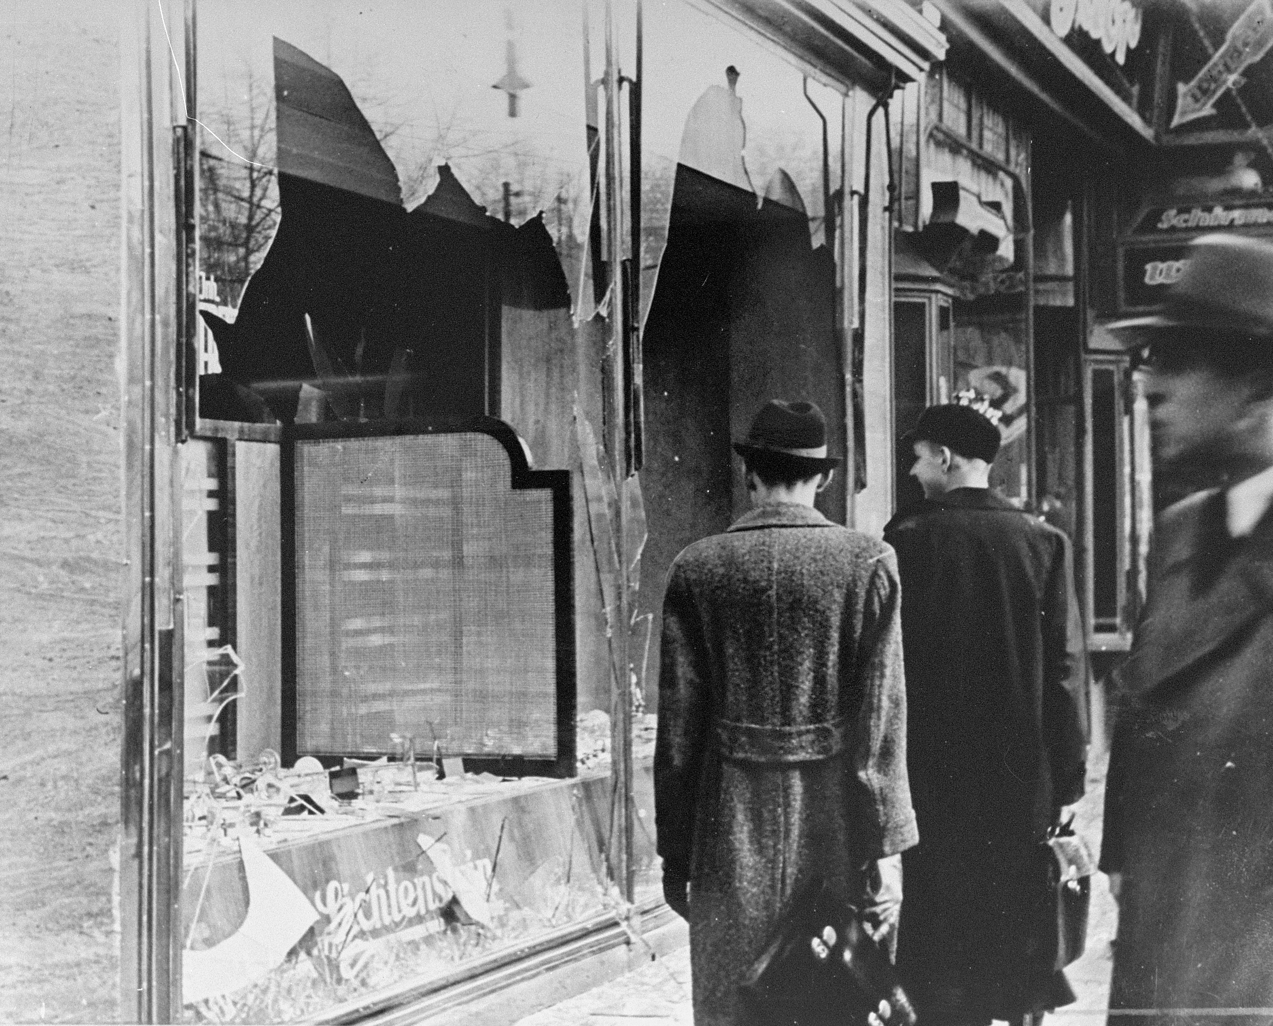
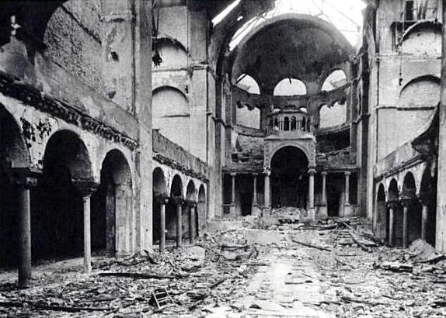
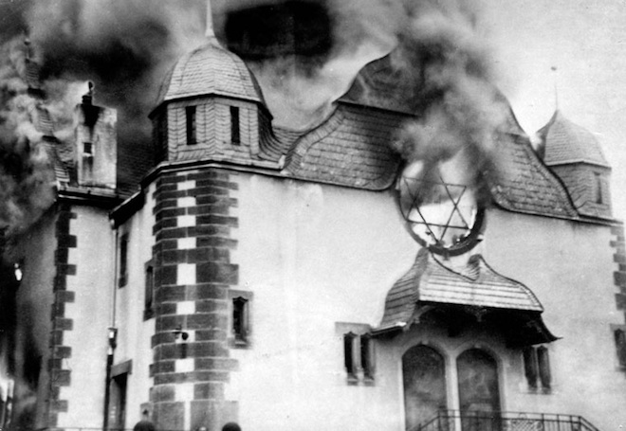
Kristallnacht – Night of Broken Glass
On November 7th 1938, a 17 year old Polish Jew shot dead a German diplomat in Paris in protest against the German government’s anti-Semitism. The Nazi leaders quickly organised a wave of anti-Jewish reprisals (revenge) in which over 8000 Jewish businesses and 200 synagogues were destroyed. Over 30,000 Jewish men were arrested and sent to concentration camps. Most of these were released within a couple of months but not before about 1000 had been murdered.
Questions
What had happened to insight Kristallnacht?
Why was this night given the name Kristallnacht?

Slide 7
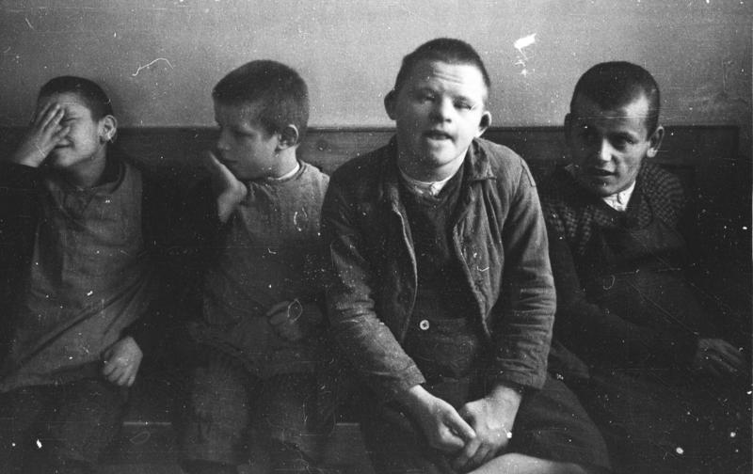
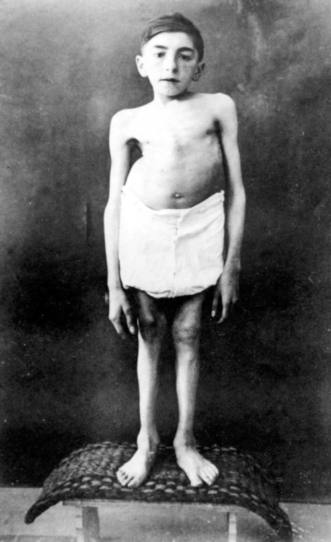
Euthanasia
One Nazi policy which did lead to protests inside Germany was euthanasia – the mass killing of physically and mentally handicapped Germans. The Nazis had already begun a policy of sterilising those people so that they couldn’t have children, but euthanasia went a step further. Between the autumn of 1939 and August 1941 70,000 men, women and children had been killed for these reasons.

Slide 8
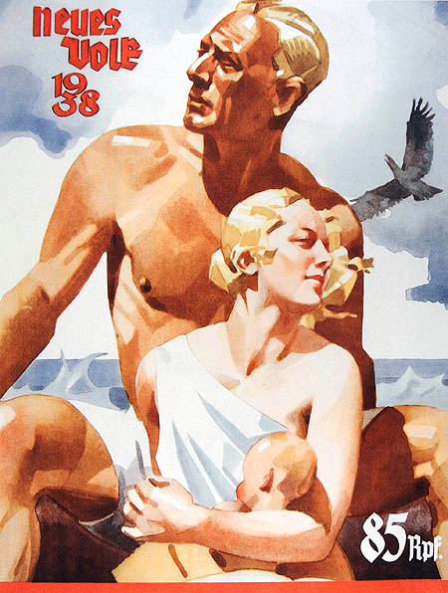
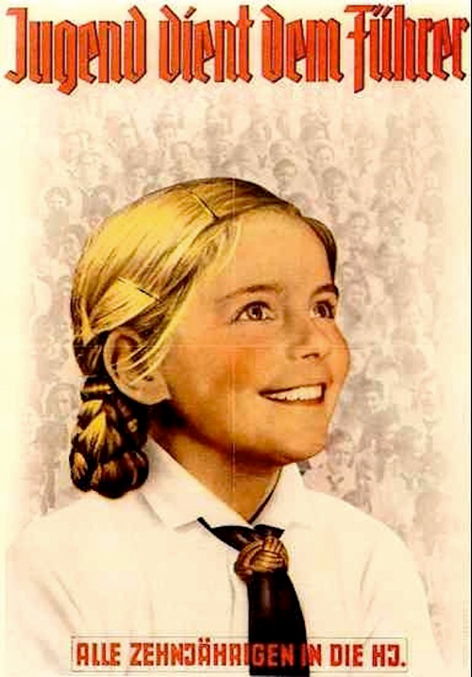
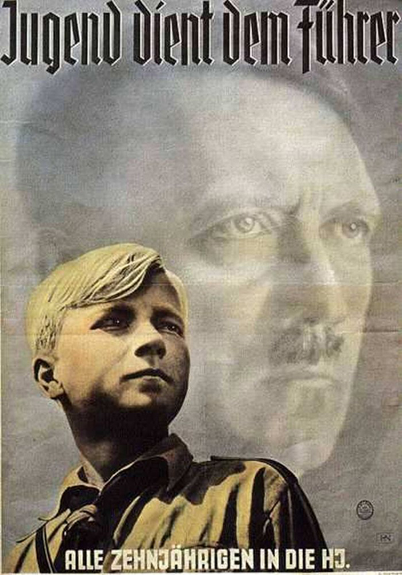
Hitler was determined to make the German people a ‘master race.’ This master race would have blue eyes and blonde hair, and no physical or mental weaknesses. There would, therefore, be no place for the handicapped. Many of the victims were gassed with carbon monoxide. The government tried to keep the programme secret but details soon leaked out. A protest by a leading German Catholic bishop in August 1941 forced Hitler to temporarily stop the policy. It was soon restarted but in greater secrecy.
Questions:
3. How did the Nazi policy affect the handicapped?
4. Why was this policy put in place? What was Hitler trying to achieve?

Slide 9
“The doctor in charge said, ‘We do not carry out the action (euthanasia) with poison, injections or other measures which can be recognised… for then the foreign press… would have new opportunities for propaganda against us… No, our method is much simpler.’
With these words he pulled a child out of its cot… He displayed the whimpering skeleton-like person like a hare which had just been caught. ‘Naturally, we don’t stop their food straightaway. That would cause too much fuss. We gradually reduce their portions. Nature then takes care of the rest… This one won’t last more than two or three days.’”
(A description of a visit in 1940 by some leading Nazis to a children’s asylum where euthanasia was carried out.)
Questions:
5. How does it make you feel knowing that doctors, who are meant to treat people and keep them alive, were helping to murder people, especially children and the handicapped?

Slide 10
Activity
Imagine you are a Jewish child in Germany in 1938. Write a letter to a friend explaining how Hitler has affected your life and that of your family:
Mention Nazi ideas about the Jews.
Show how these ideas have affected Jews.
Explain why Hitler’s policies have sometimes changed.
Sum up by saying what life is like in 1938 and what your fears (or hopes) are for the future.

