Slide 1
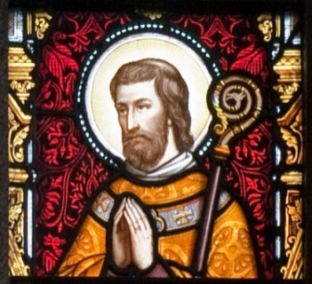
St. Aidan of Ferns

Slide 2
As a small boy, Aidan was held as a hostage by the High King of Ireland, Áedh Mac Ainmuirech of the Cenél Conaill.

Slide 3
Aidan studied to become a monk under St Finnian of Clonard.

Slide 4
He fasted on barley bread and water for 7 years and recited 500 psalms every day.

Slide 5
In 580, Aidan returned to Ireland, going to the coast of Wexford. Here he served in the area around Ferns

Slide 6
When he wanted to build the monastery, he blessed the hands of an untrained man and he became a great builder and decorator for St. Aidan’s monastery.

Slide 7
He founded a monastery in Ferns, Co. Wexford and became the first bishop of Ferns.

Slide 8
St Aidan is known for his many miracles showing his generosity and kindness. One story tells how people dressed as beggars asked Aidan for help; but knowing what they had done, Aidan gave away their clothes to some more deserving poor, and sent off the imposters with neither clothes nor alms.

Slide 9
He pulled two young men , feared dead, from the water alive.

Slide 10
One day, while out studying and praying, a deer ran in his direction, wanting protection from a dog. He put the tablet on which he was writing on the head of the deer and it became invisible until the dog passed.

Slide 11
He died on 31 January 631. A bronze reliquary in which his relics were kept in the 11th century is preserved in Dublin.

Slide 12
FOR YOU TO DO
St. Aidan’s work today….
Can you find a news story from the last week where someone protected an animal in distress or performed a heroic rescue or encouraged/helped an untrained person gain new skills or get a job?

