Slide 1
Our Lady’s Birthday
September 8th
Produced by the Association of Catholic Teachers (ACT)

Slide 2
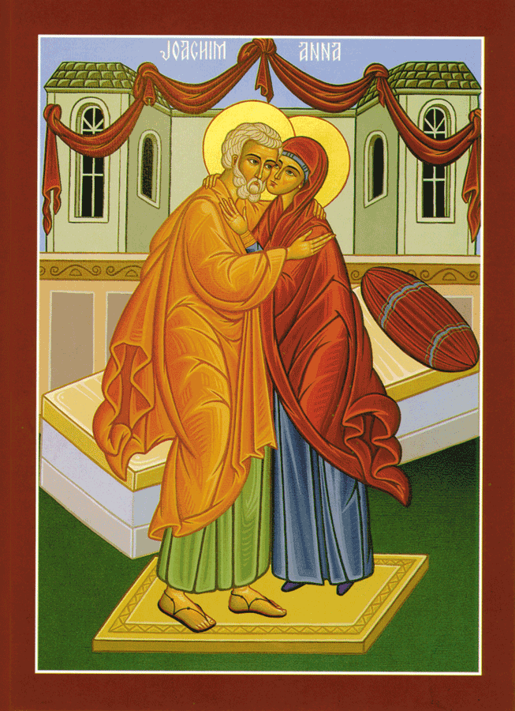
Mary’s Parents
According to tradition Mary’s parents were Joachim and Anne.

Slide 3
God answers their prayers
Joachim and Anne prayed to God and had much faith. God answered their prayers and Anne was soon expecting a child.

Slide 4
The Immaculate Conception
We celebrate this feast day on December 8th. This means that from the moment of her existence in Anne’s womb, Mary was free from sin. She was “immaculate”. She never sinned in her life!

Slide 5
The Immaculate Conception
God kept Mary free from sin because she was to have the privilege of carrying His Son Jesus in her womb later in her life.
(When Our Lady appeared to Bernadette at Lourdes in 1858 she told Bernadette that she was the “Immaculate Conception”).

Slide 6
The Birth of Mary
Exactly 9 months after the Immaculate Conception we celebrate the birth of Mary on September 8th.

Slide 7
Celebrations of Our Lady’s birthday today
The winegrowers in France called this feast "Our Lady of the Grape Harvest". The best grapes are brought to the local church to be blessed and then some bunches are attached to hands of the statue of Mary. A festive meal which includes the new grapes is part of this day.

Slide 8
Celebrations of Our Lady’s birthday today
In some parts of Austria, milk from this day and all the leftover food are given to the poor in honour of Our Lady’s Nativity.
In some parts of Italy there are devotions to “Maria Bambina” (baby Mary) on September 8th dating back to the 1800s and often a Novena of prayers (for 9 days) is prayed.

Slide 9
Happy birthday to Our Lady!
Here are some suggestions as to how we can say “Happy Birthday” to Our Lady:
Say the Rosary / Angelus
Visit a shrine to Our Lady
Sing a hymn eg.”Hail Queen of Heaven”
“As I Kneel before You”
Decorate our sacred space with a statue or picture of Mary and some flowers

