Slide 1
International Nonviolence Day 2012

Slide 2
Gospel story: Matthew 5:38-46 (The sermon on the mount)
You have heard that it was said, ‘An eye for an eye and a tooth for a tooth.’ But I say to you, Do not [violently] resist an evildoer. But if anyone strikes you on the right cheek, turn the other also; and if anyone wants to sue you and take your coat, give your shirt as well; and if anyone forces you to go one mile, go also the second mile.
You have heard that it was said, ‘You shall love your neighbour and hate your enemy.’ But I say to you, Love your enemies and pray for those who persecute you, so that you may be children of your Father in heaven; for he makes his sun rise on the evil and the good, and sends rain on the righteous and on the unrighteous. For if you love those who love you, what reward do you have? Do not even the tax collectors do the same?

Slide 3
What is Nonviolence?
Nonviolence is not only avoiding hurting people, but it is a positive state of love, of doing good even to the evildoer.
But it does not mean helping the evildoer to continue the wrong or tolerating it by doing nothing.
Human beings are more than the evil they sometimes commit
We are called to celebrate both our differences and our fundamental unity with others and to work for the well-being of all

Slide 4
Everyday Nonviolence- The Golden Rule
“love your neighbour as yourself”
Our neighbor is more than the person next door, your neighbor could be anyone in your school, community or almost anyone we meet at any time. It could be our enemies.
How can we love someone who acts hatefully toward us? This is a huge challenge.

Slide 5
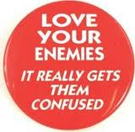
Love your neighbour as yourself
Simply means respecting others and regarding their needs and desires as highly as we regard our own needs and desires.
Treating others as you would like to be treated.

Slide 6
Nonviolence is active
Nonviolence actively works for peace and justice
Nonviolence seeks to change the powers that be without the use of coercive force
Nonviolence uses peaceful and just means
Nonviolence resists evil without becoming evil
Nonviolence understands that the ends and the means are one
But is it realistic??

Slide 7
Nonviolence works!
Nonviolence has been used in many countries throughout history in the struggle for justice
"In 1989, thirteen nations comprising 1,695,000,000 people experienced nonviolent revolutions that succeeded beyond anyone's wildest expectations ... If we add all the countries touched by major nonviolent actions in our century (Korea, the Philippines, South Africa ... the independence movement in India ...), the figure reaches 3,337,400,000, a staggering 65% of humanity! All this in the teeth of the assertion, endlessly repeated,that nonviolence doesn't work in the 'real' world.” Walter Wink

Slide 8
But what about Hitler?
Nonviolence worked against Hitler:
In Norway and Denmark nonviolence was used to make Nazi rule there unworkable
Hitler would never have been able to take over the world- to do so he would need to kill everyone who disagreed with him and his policies or else convince everyone he was right
Proper education and simple nonviolent resistance would soon convince people that Nazism and other poisonous ideas are not good for anyone

Slide 9
“Everyone but Christians understand that Jesus was nonviolent.”-Gandhi

Slide 10
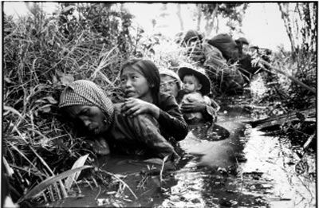
So what about Christians?
Christians have killed more people in the history of the world than any other defined group of people
Crusades, Inquisition, Genocide in the Americas, the Reformation etc…
WW1 - 9 million people died with 10% civilians dead.
WW2 – 52 million people died with 48% civilians dead.
Christians make up largest
part of armies fighting in
Afghanistan today

Slide 11
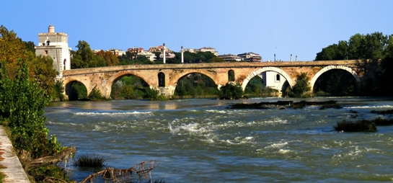
Constantine at the Milvian Bridge on 28th October 311
In 313 Christianity becomes the official religion. In 310 Christians were not allowed join the army – in 410 only Christians could join the army.
St. Ambrose (337-97) in 368 wrote on the “Just War Theory” – developed by St. Augustine (d.430).

Slide 12
Turning Point
The conversion of Constantine represented a turning point in the history of the Church
It officially walked away from Jesus’ nonviolent way of love of friends and enemies
Christianity now had valuable property and with this came the necessity to protect that property with violence when required
Bishops in the Church became Civil Servants of the Roman State which was backed up by the military might of the Roman Army

Slide 13
DISARMING OF THE HEART
“But I say to you, love your enemies, and pray for those who persecute you, that you may be children of your Father in heaven”.
Matt 5: 43-45
Returning hate for hate
multiplies hate. This chain of violence must be broken.
Love is the only force
capable of transforming an
enemy into a friend.
To be children of God means to actualise our unique relationship with God, and this means to act lovingly towards all.

Slide 14
“Violence does not build up the kingdom of God, the kingdom of humanity. On the contrary it is the favourite instrument of the Antichrist, however idealistic its religious motivation may be”. - Pope Benedict XVI

Slide 15
Violence wins temporary
victories and creates
permanent problems.
Revd John Simpson

Slide 16
God loves everyone,
his friends and enemies,
and so must we.
Ronald Sider, in ‘Christ and Violence’

Slide 17
We must meet violence
with non-violence.
We must meet hate
with love.
Martin Luther King (1929 – 1968)
after his home was bombed.

Slide 18
Taking an eye for an eye
will make the whole
world blind.
Mahatma Gandhi (1869 – 1948)

Slide 19
Our nuclear missiles are already killing people, because we waste on missiles resources which could be invested in
ensuring food supplies
for the world.
Robin Cook, Labour MP

Slide 20
Peace cannot be kept
by force. It can only
be achieved by
understanding.
Albert Einstein (1879 – 1955),
after the bombing of Hiroshima

Slide 21
If mankind does
not kill war,
war will kill mankind.
Louis Pasteur (1822 – 1895),
father of modern bacteriology

Slide 22
I am always glad to hear
of a soldier becoming a
Christian, but I am always
sorry to hear of a Christian
becoming a soldier.
Charles Haddon Spurgeon (1834 – 1892) in 1857

Slide 23
Because I am a Christian,
I cannot serve as a soldier;
I cannot do evil.
Soldier who became a Christian c 300 AD

Slide 24
Nonviolence is the greatest
Force at the disposal of
Mankind. It is mightier than
The mightiest weapon
Devised by genius of man.
Gandhi

Slide 25
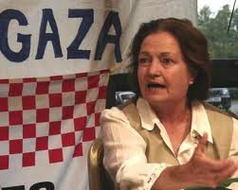
Máiread Corrigan-Maguire 1944 -
“One great hope lies in the fact that there is a new consciousness in our World, particularly among young people”.

Slide 26
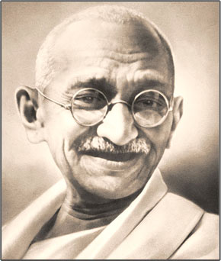
Mahatma Gandhi: 1869-1948 “If we are to teach real peace in this world, and if we are to carry on a real war against war, we shall have to begin with the children.”

Slide 27
Prayer of Saint Francis of Assisi
Lord, make me an instrument of your peace.
Where there is hatred, let me sow love; where there is injury, pardon; where there is doubt, faith; where there is despair, hope; where there is darkness, light; and where there is sadness, joy. O Divine Master, grant that I may not so much seek to be consoled as to console; to be understood as to understand; to be loved as to love. For it is in giving that we receive; it is in pardoning that we are pardoned; and it is in dying that we are born to eternal life. Amen

